Slide 1
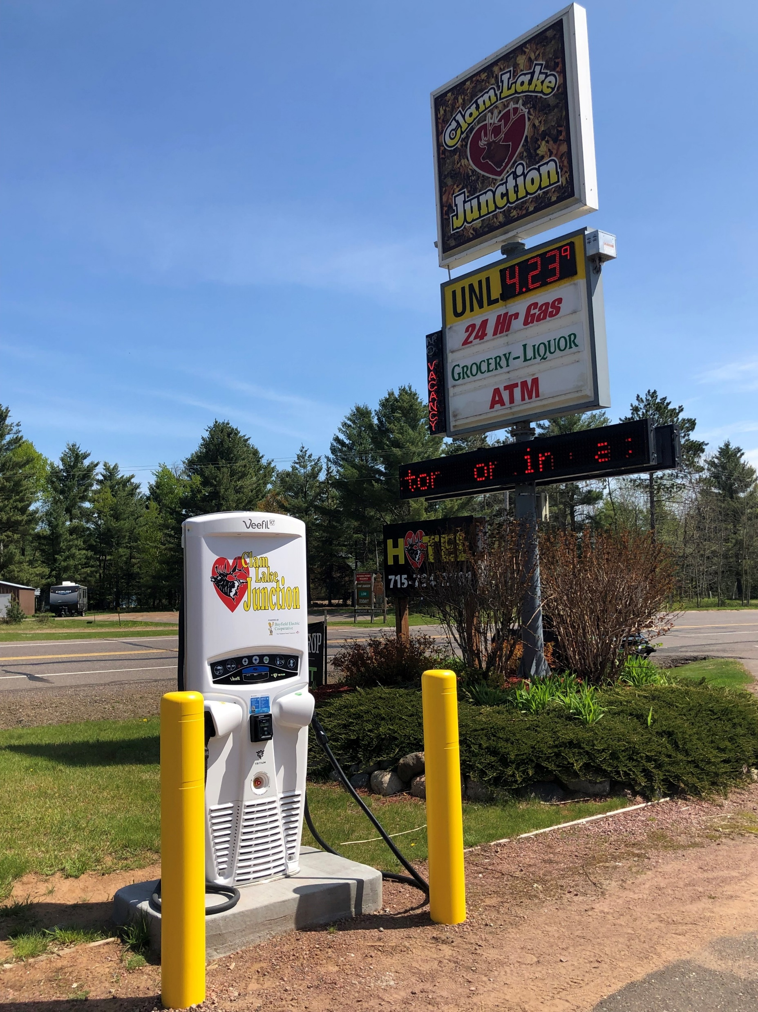
Funding Opportunities for EV Infrastructure
Ashland County Charges Ahead
Cheq Bay Renewables
Clam Lake DCFC

Slide 2
Homeowner
Business
Municipality
Nonprofit
Tribe
Funding depends on who you are

Slide 3
Xcel
EV Accelerate at Home
Commercial Program Credits
Bayfield Electric
Rebates
Dahlberg
New Programs in Development
Incentives depend on your utility

Slide 4
Residential Level-2
10kW $620
19kW $2000
Commercial Level-2
15kW Pedestal with Card Reader $10,600
Commercial Level-3
150kW $97,300
Charging Equipment (EVSE) costs vary by capacity and features

Slide 5
Residential Level-2
240v available $200
Upgrade service $2000
Commercial Level-2
Site dependent $2000 - $10,000
Commercial Level-3
Site Dependent - $80K to $120K
Installation costs also vary by EVSE capacity and site

Slide 6
Electric Bill
Energy Charges (kWh)
Monthly Fees
Cellular Plan
Credit Card Fees
Operations & Maintenance
Contract with EVSE Vendor
Demand Charges (kW)
Costs continue after installation

Slide 8
Funding
Grants
Utility Programs
Tax Credits
1) Tax Credits
2) Utility Programs
3) Grants

Slide 9
Tax Credits
PART 1

Slide 10
Instructions for Form 8911 (01/2023) | Internal Revenue Service (irs.gov)

Slide 11
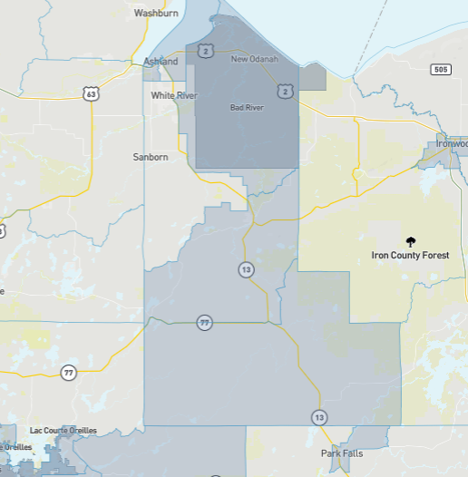
Homeowner Alternate Fuel Tax Credit
Must be in eligible census tract (disadvantaged)
20% poverty rate or greater, or
80% of State median income
Maximum credit smaller of 30% or $1000
Ashland County Disadvantaged Areas (Grey)

Slide 12
Ashland County Census Tracts
50400 Eligible
50800 Eligible

Slide 13
Ashland County Census Tracts
50300 Not Eligible
50500 Not Eligible

Slide 14
Ashland County Census Tracts
50600 Eligible
50700 Eligible

Slide 15
Business Alternate Fuel Tax Credit
6% tax credit not to exceed $100K
May be eligible for 30% if wage and apprenticeship requirements met
Must be in eligible census tract, OR
Is NOT an urban area
Federal Register :: 2020 Census Qualifying Urban Areas and Final Criteria Clarifications
Ashland County Disadvantaged Areas (Grey)

Slide 16
Elective Pay Alternate Fuel Tax Credit
Municipalities, nonprofits, and tribes and now claim tax credit(s)
Use same rules as a business
Previously called Direct Pay
Also applies to renewable energy projects

Slide 17
Utility Programs
Part 2

Slide 18
Utility EVSE Programs for Homeowners
Bayfield electric cooperative
Xcel Energy
Rebate for home chargers
$400 EVSE
$800 Smart EVSE with internal meter
Both options are on load control program
Additional programs in development
“EV Accelerate at Home”
EVR-1 tariff
Must be under Residential (Rg-1) or Farm Service (Fg-1)
Residential Time-of-Day (Rg-2) or Parallel Generation (Pg-1) is not eligible

Slide 19
Xcel Residential EV Accelerate at Home Rates

Slide 20
Xcel Program Chargers

Slide 21
Xcel Program Costs/Pricing

Slide 22
Residential EVSE Comparison – Initial Installation
Charger | EVSE | EVSE Setup | 240v to Charger | Utility Rebate | Tax Credit (if eligible) | Total
Xcel - EVR-1 JuiceBox 40a, 9.6kW | $780 | Included | $500? |  | ($384) | $896
Xcel – Rg-1 JuiceBox 40a, 9.6kW | $617 | $150 | $500? |  | ($380) | $887
Bayfield Electric – JuiceBox 40a, 9.6kW | $617 | $150 | $500? | ($800) | ($140) | $327

Slide 23
Residential EVSE Comparison – After Installation
Utility Tariff | Annual Miles Driven | Annual kWh | Annual kWh $ if Charge at Night or Weekends
Xcel - EVR-1 EV Sedan | 15,000 | 3,750 | $253
Xcel – Rg-1 EV Sedan | 15,000 | 3,750 | $499
Bayfield Electric Cooperative EV Sedan | 15,000 | 3,750 | $480
Xcel or BEC with 3.1 kW Solar PV | 15,000 | 3,750 | $0

Slide 24
Xcel’s Commercial EV Program (EVC-1)
Embedded Program Credits
Off-peak Rates
Demand Charges
Demand Limiters

Slide 25
Xcel’s Commercial EV Program (EVC-1)
Embedded Program Credits - Example
Total Cost 4-port L2 & L3 | Grant 80% | Cost Share 20% | Xcel Program Credit | Cost to Site Owner
$276,553 | ($221,243) | ($55,311) | ($58,097) | $0

Slide 26
Xcel’s Commercial EV Program (EVC-1)
Off-peak Rates – Example Bayfield County Fleet 2022
 | Miles driven | 2022 cost of gasoline ($3.60/gal) | Cost of off-peak electricity equivalent ($0.056/kWh) | 2022 EV Savings %
Bayfield County fleet | 345,900 | $41,508 | $4,843 | 88%

Slide 27
Xcel’s Commercial EV Program (EVC-1)
Demand Charges
- Demand Limiters
Charging Station | Monthly Hours Used | kWh Used
Two L3 150kW | 10 | 1500
Two L2 15kW | 20 | 300
Total |  | 1800
Revenue at $0.30/kWh |  | $540
4-port Station | Capacity kW | Demand Charge On-peak Summer ($13/kW) | Adjusted Demand 150 Limiter | Adjusted Demand Charge
2 L3 & 2 L2 | 330 | $4290 | 12 (1800kWh/150) | $156

Slide 28
CBR Tool
Enter EVSE capacity and estimated hours used – results Xcel electric bill and rate per kWh:
ev_charging_electric_bill_analysis_xcel.v5protected.xlsx (live.com)

Slide 29
GRANTS
Rural EV Toolkit: Rural EV Toolkit (PDF Version) | US Department of Transportation
Funding Table: Rural EV Infrastructure Funding Table (PDF Version) | US Department of Transportation
Funding Table: Rural EV Funding Table.xlsx (live.com)
80 Grant or Loan Programs Listed

Slide 30
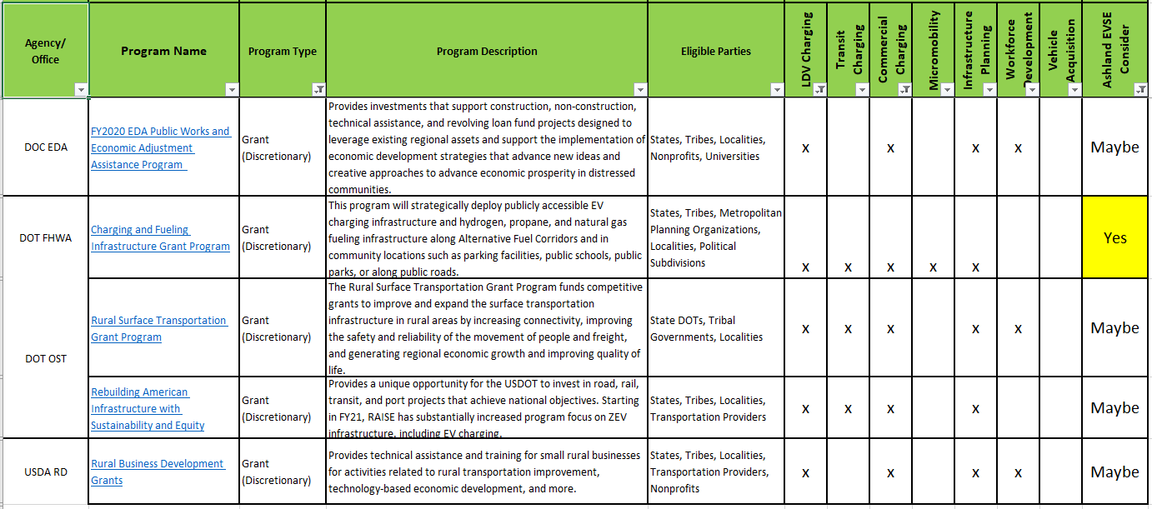

Slide 31
List of some Grants for EVSE
Municipalities and tribes
Nonprofits
U.S. Department of Transportation – Charging and Refueling Infrastructure (CFI)
WI Department of Transportation – Wisconsin Electric Vehicle Infrastructure (WEVI) (Next month topic)
VW Funds – Through State of WI, details TBD
EVs for Good - EVs for Good - RENEW Wisconsin
farms and rural business
USDA Rural Energy for America Program (REAP)

Slide 32
U.S. DOT (FHWA) CFI Grant
$700M in two separate categories
$350M Corridor Program,
$350M Community Program
Either program must comply with NEVI Standards and Requirements
4-port minimum
Public access
Contactless payment methods
Connector types
Etc.

Slide 33
FWHA Priorities
Safety
Carbon Reduction
Equity & Justive40
Workforce Development
Accessibility

Slide 34
DOT CFI Highlights
Eligible applicants
Few details
States
Local units of government
Tribes
80% grant/ 20% cost share
All aspects of an EVSE project are eligible expenses
Community Program can use funds for secondary roads
Minimum grant $500K, maximum $15M

Slide 35
DOT CFI Grant Writing Components
Extensive narrative requirements
Budget information
Project Merit Criteria
Safety
Climate Change
Equity, Community Engagement, and Justice40
Workforce Development, Job Quality and Wealth Creation
CFI Program Vision
Project Readiness and Environmental Risk

Slide 36
DOT CFI GRANT WRITING
Who is going to take the lead?
Narrative research and writing: 80-100 hours (or more?)
Community engagement: 40 hours (or more?)
Town meeting
City Council meeting
County Board meetings
Various committee meetings
Meeting with site hosts
Engage with utilities: 10-15 hours

Slide 37
DOT CFI Example – Bayfield County Submitted June 13, 2023
Key ingredients
results
11 sites with 4 ports each
Mix of Level-2 and Level-3 chargers
All sites in Xcel Energy territory
Xcel’s commercial EV tariff (EVC-1) has Program Credits which covers the 20% cost share
Xcel has “demand limiter” formula in tariffs to reduce demand charges for small usage
Ownership transfers from Bayfield County to 11 site owners
No cost to site owners
First 5-years of O&M covered by project
Electric bills covered by paying customers
One L2 charger used one hour/day = $22K in annual economic benefit to community

Slide 38
Site Description | Engineering & Distribution | EV Supply Infrastructure (EVSI) | EV Supply Equipment (EVSE)+O&M | Safety Equipment. ADA Compliance | County Administration | Contingency | Site Total
Ashland | $26,500 | $74,900 | $224,121 | $7,860 | $4,000 | $34,868 | $383,544
Bayfield | $18,500 | $74,900 | $136,387 | $5,860 | $4,000 | $25,141 | $276,553
Cable | $19,000 | $74,900 | $136,387 | $5,860 | $4,000 | $25,191 | $277,103
Cornucopia | $12,500 | $74,900 | $136,387 | $5,860 | $4,000 | $24,541 | $269,953
Drummond | $14,500 | $74,900 | $136,387 | $6,360 | $4,000 | $24,791 | $272,703
Grandview | $8,500 | $74,900 | $136,387 | $5,860 | $4,000 | $24,141 | $265,553
Herbster | $2,000 | $74,900 | $136,387 | $5,860 | $4,000 | $23,491 | $258,403
Lakewood | $13,750 | $74,900 | $136,387 | $5,860 | $4,000 | $24,666 | $271,328
Red Cliff | $5,000 | $74,900 | $136,387 | $7,860 | $4,000 | $23,991 | $263,903
Washburn | $9,500 | $74,900 | $224,121 | $7,860 | $4,000 | $33,168 | $364,844
Port Wing | $25,500 | $74,900 | $136,387 | $6,360 | $4,000 | $25,891 | $284,803
Subtotal | $155,250 | $823,900 | $1,675,725 | $71,460 | $44,000 | $277,034 | $3,047,369
% of Total | 5.1% | 27.0% | 55.0% | 2.3% | 1.4% | 9.1% | 100%
Bayfield County DOT CFI Budget

Slide 39
Site Description | Total with Contingency | Grant Request 80% | 20% Cost Share Requirement | Est. Xcel Program Credit | Excess Program Credit | Site Owner NET COST ESTIMATE
Ashland | $371,119 | ($296,895) | ($74,224) | ($96,232) | ($22,008) | $0.00
Bayfield | $263,612 | ($210,889) | ($52,722) | ($58,394) | ($5,672) | $0.00
Cable | $264,162 | ($211,329) | ($52,832) | ($58,394) | ($5,562) | $0.00
Cornucopia | $257,012 | ($205,609) | ($51,402) | ($58,394) | ($6,992) | $0.00
Drummond | $259,762 | ($207,809) | ($51,952) | ($58,394) | ($6,442) | $0.00
Grandview | $252,612 | ($202,089) | ($50,522) | ($58,394) | ($7,872) | $0.00
Herbster | $245,462 | ($196,369) | ($49,092) | ($58,394) | ($9,302) | $0.00
Lakewood | $258,387 | ($206,709) | ($51,677) | ($58,394) | ($6,717) | $0.00
Red Cliff | $250,962 | ($200,769) | ($50,192) | ($58,394) | ($8,202) | $0.00
Washburn | $352,419 | ($281,935) | ($70,484) | ($96,232) | ($25,748) | $0.00
Port Wing | $271,862 | ($217,489) | ($54,372) | ($58,394) | ($4,022) | $0.00
Total | $3,047,369 | ($2,437,895) | ($609,474) | ($718,014) | ($108,540) | $0.00
Bayfield County DOT CFI Budget (continued)

Slide 40
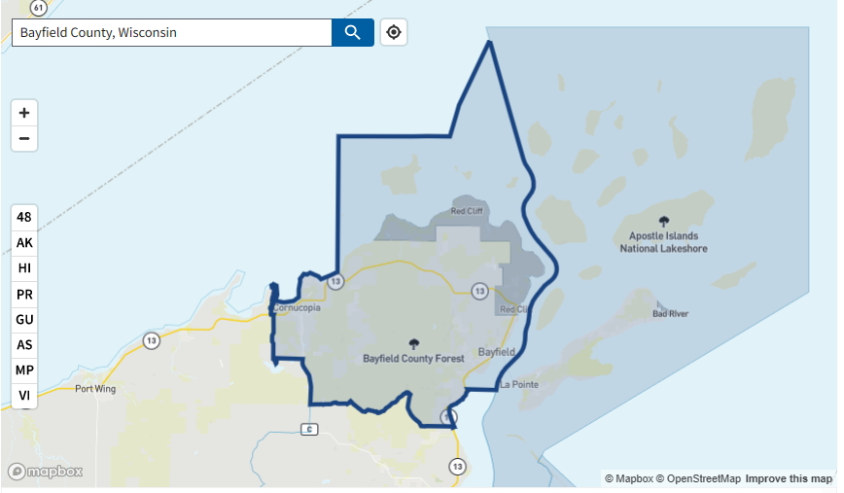
Bayfield County’s only disadvantaged census tract

Slide 41
Community Engagement
Bayfield County Executive Committee, May 11, 2023
Bayfield County Board of Supervisors, May 30, 2023
Town of Bell, May 9, 2023
Town of Clover, April 25, 2023
Town of Port Wing, April 28, 2023 and June 5, 2023
Town of Grandview, May 10, 2023
Town of Drummond, May 9, 2023
Town of Namakagon, June 13, 2023
City of Bayfield, May 11 Public Works, May 17 City Council
City of Washburn, May 8, 2023 City Council
City of Washburn June 12, 2023 City Council
Red Cliff Planning administration, various dates and initiatives
Lots of meeting and time spent

Slide 42
Workforce Development – Another key grant focus
Jobs Created or Sustained
Entity | Job Description | Number of Jobs
Xcel Energy | Engineer/Design | 2
 | Project Manager | 1
 | Construction Crew | 4-6
 | Administration | .5
EVSE Vendor | Project Manager | 1
 | Manufacturing jobs | 3-4
 | EVSE Technician | 1
Bayfield County | Project Manager/Reporting | .75
Red Cliff | Casino Maintenance/Reporting | .25
Other Site Owners | Maintenance/Reporting | .25 *10
Total Jobs Created or Sustained |  | 16-20

Slide 43
Bayfield County DOT CFI Application
Link to read application narrative:
project_narrative_final_mergedv8.pdf (cheqbayrenewables.org)

Slide 44
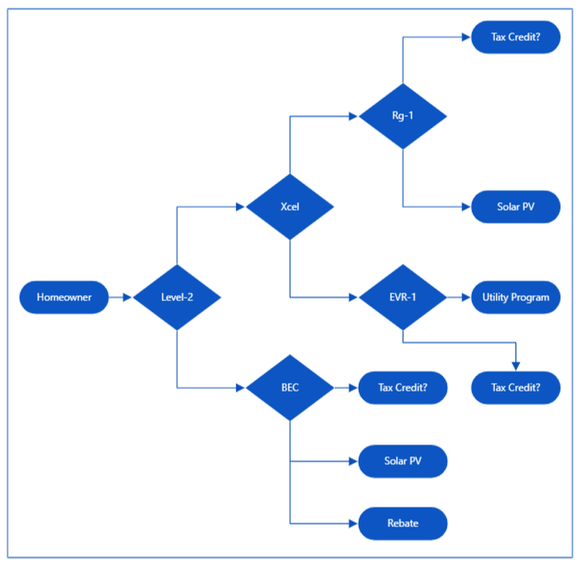
In Summary:
Homeowner EVSE Flowchart
Legend:
BEC – Bayfield Electric Co-op
Rg-1 Residential Service
EVR-1 Electric Vehicle Residential

Slide 45
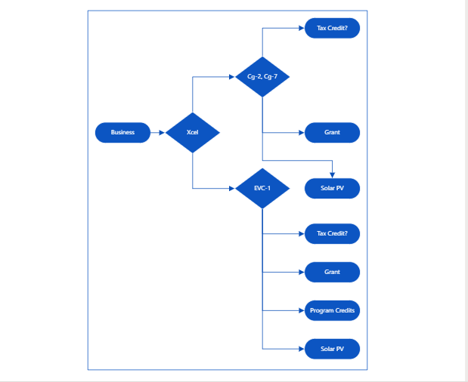
Business
Utility – Xcel Energy
Funding Sources
Legend:
Cg-2 Small General Service
Cg-7 General Service Time of Day
EVC-1 Electric Vehicle Commercial

Slide 46
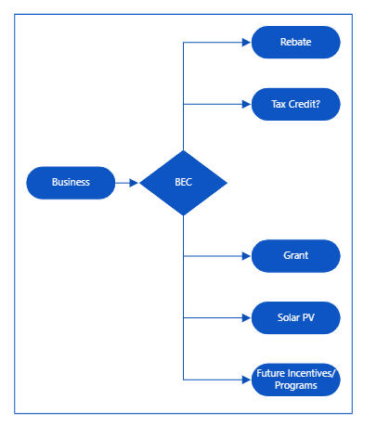
Business
Utility = Bayfield Electric
Funding Sources

Slide 47
Thank You
Bill Bailey
billebailey2@gmail.com
www.cheqbayrenewables.org
From Cheq Bay Renewables

