Slide 1
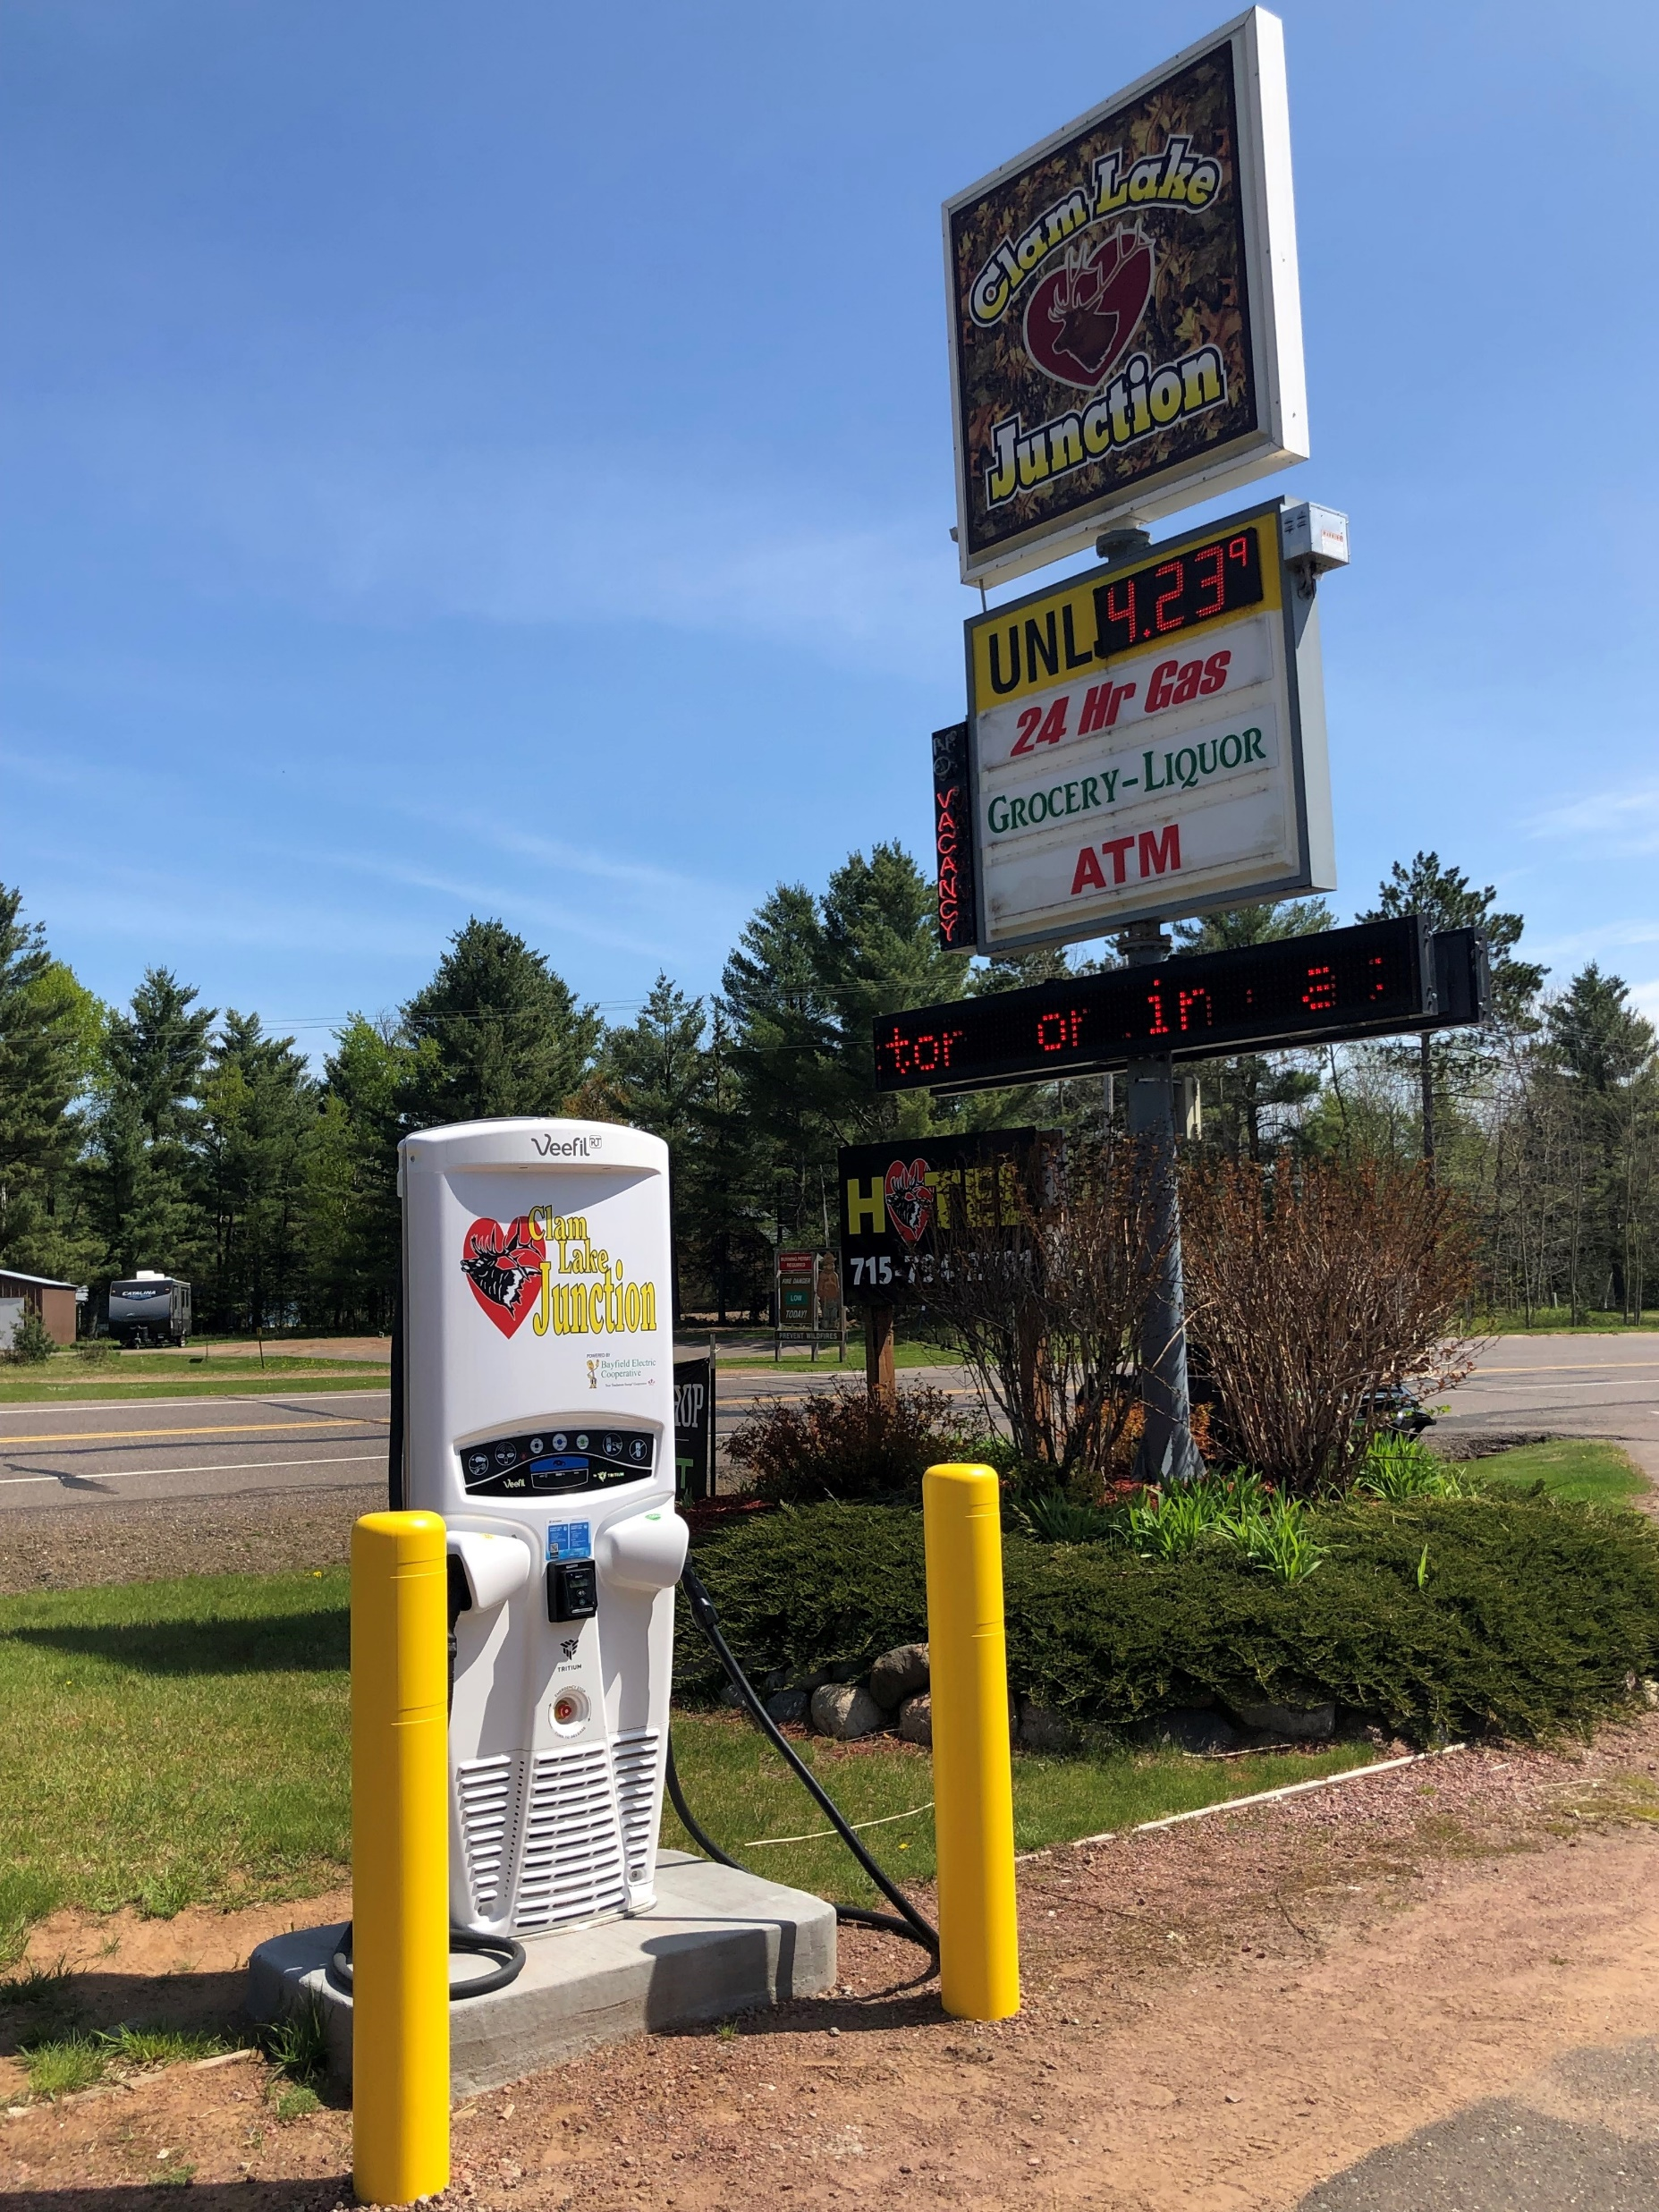
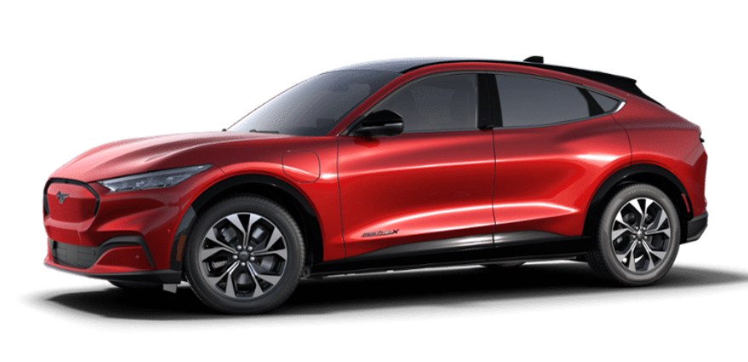
Preparing for Funding Applications – Part 2
Ashland County Charges Ahead
Cheq Bay Renewables
Clam Lake DCFC

Slide 2
Topics – Format is Open Discussion
WI DOT EV Corridor Grant
Review DOT CFI Grant – Next Steps
EV Models available now
Level-2 chargers for your home – how to select
DOE ERA Grant – Review
Other Topics - Open Discussion

Slide 3
Topic 1 - Wisconsin Electric Vehicle Infrastructure (WEVI) Plan
Part of the National EV Infrastructure (NEVI) Plan
$78.65 million for Wisconsin
Part of $7.5B from BIL over 5 years
WI Department of Transportation will administer: Wisconsin Electrification Initiative (WIEV)
First round of funding – EV charging stations every 50 miles along designated corridor
Must be within one mile of designated highway

Slide 4
WIEV Scenarios – One EVSE every 50 miles
None in Ashland County
One in Odanah
One in City of Ashland

Slide 5
Potential Level-3 Sites for WEVI/WIEV in Ashland
Chosen Sites
Kwik Trip #110 (West)
Kwik Trip #118 (East)
Kwik Trip #163 (Ellis)
Midland Services
Other Potential Sites
Walmart
Walgreens
L&M Fleet Supply
Wagner’s Shell
Others?
Purple icons are potential “Chosen Sites”

Slide 6
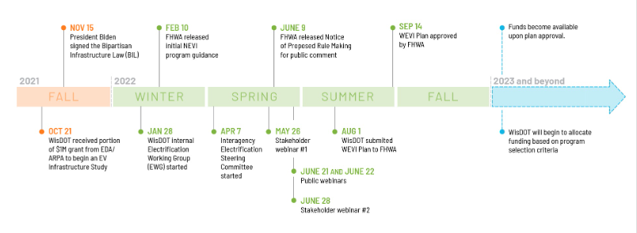
Wisconsin Department of Transportation Electrification of Wisconsin (wisconsindot.gov)

Slide 7
WIEV Next Steps
Let’s get ready:
Form a WIEV/DOT CFI Committee
Contact potential site owners
Contact Xcel when have a site confirmed
Continue public engagement
Timeline:
Early August announcement/update
Grant application release likely in fall 2023, but may be later
WI legislative bill upcoming includes sale by kWh and budget
North America Charging Standard (NACS – Tesla) vs. Combined Charging System (CCS)

Slide 8
Topic 2 - Review U.S. DOT CFI Grant
DOT CFI has a Corridor Program which might look similar: CFI - Environment - FHWA (dot.gov)
CBR submitted an application on June 13, 2023 which can be used as a template: project_narrative_final_mergedv8.pdf (cheqbayrenewables.org)
Remember, focus will be on:
Community Engagement
Workforce Development
Justice40
Thes are initiatives that need started now to be ready for WIEV & DOT CFI

Slide 9
What’s your next car?
Topic 3 - EV Models Available Now
EV’s are here!

Slide 10
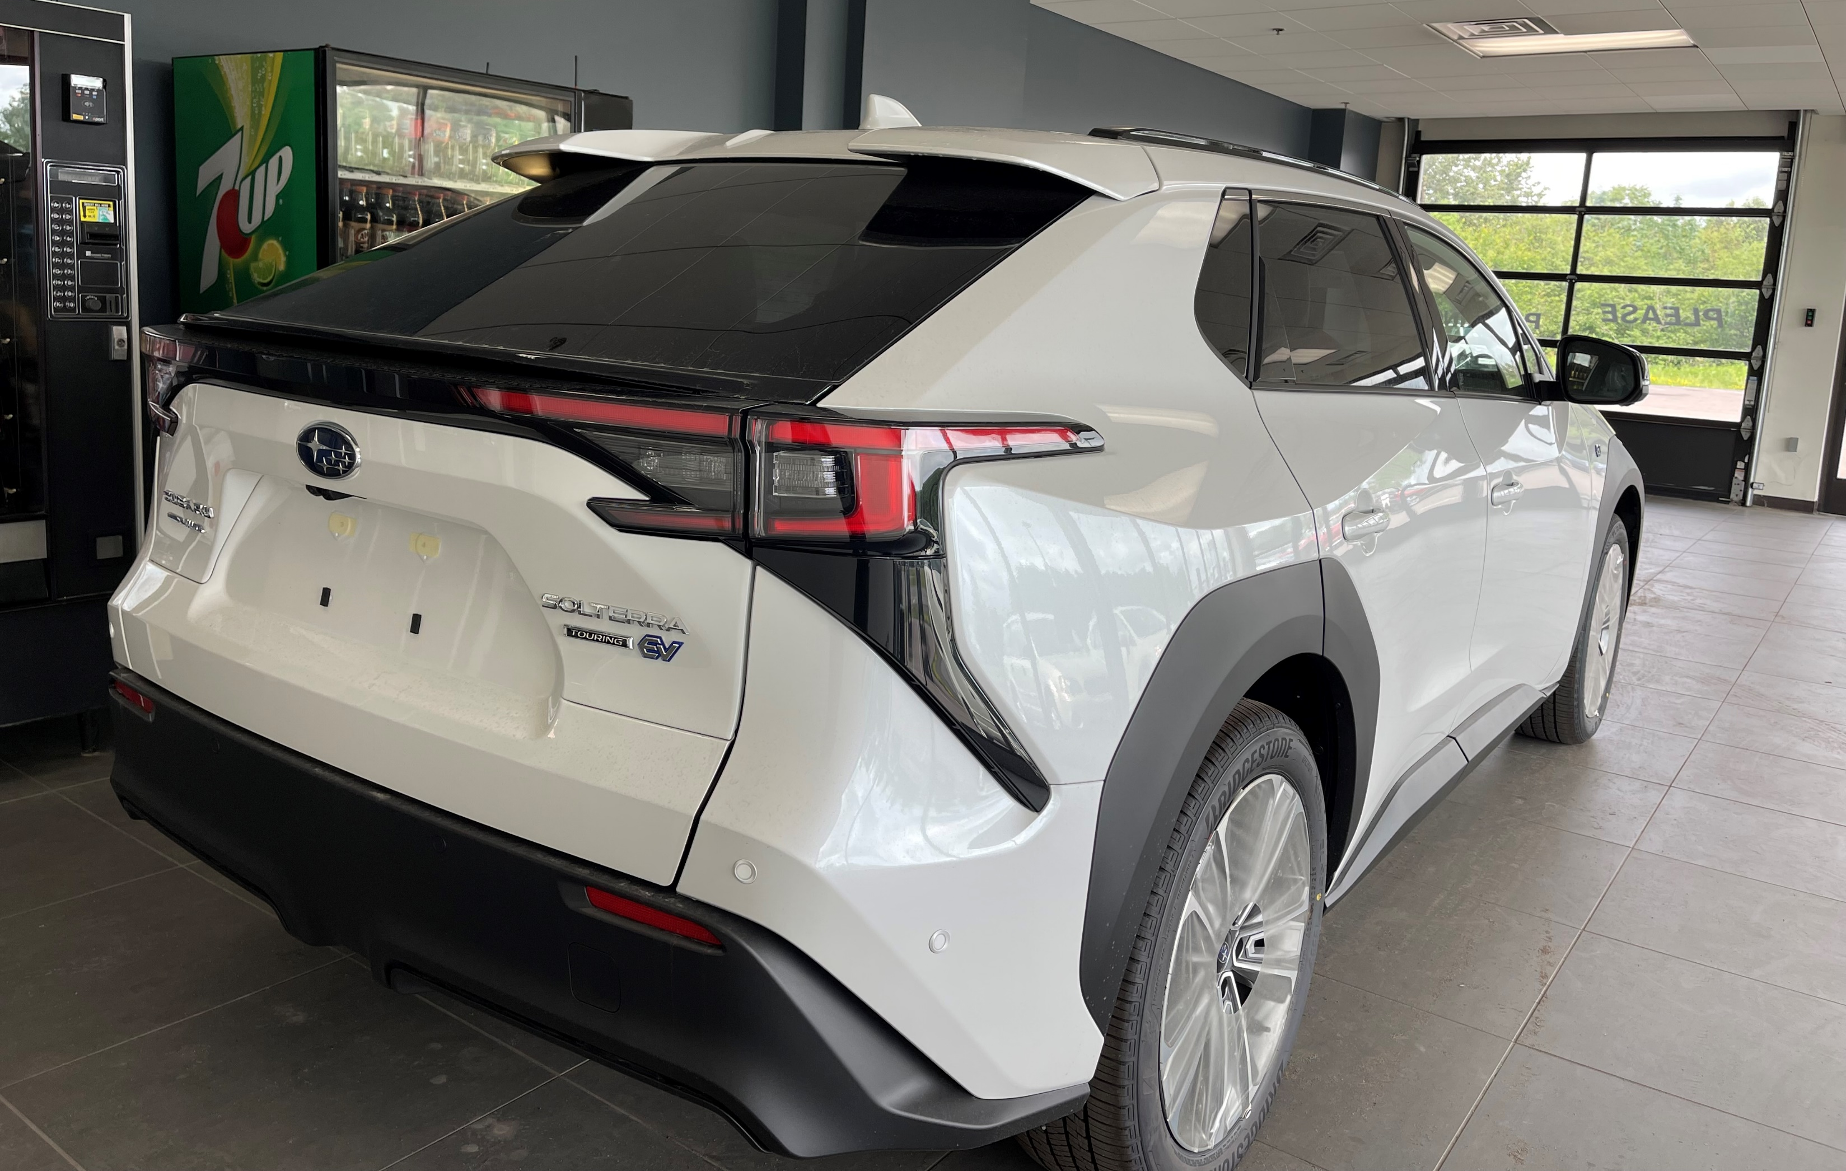
Subaru Solterra Touring

Slide 11
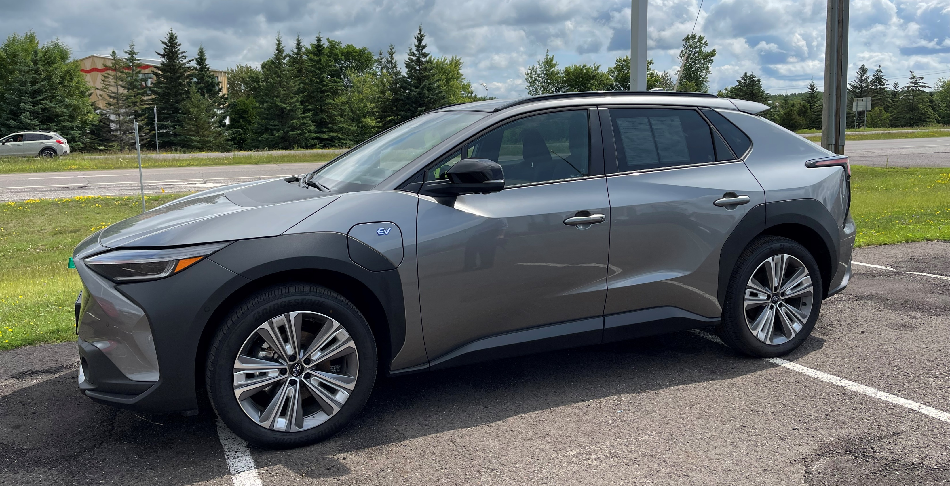
Subaru Solterra Limited

Slide 12
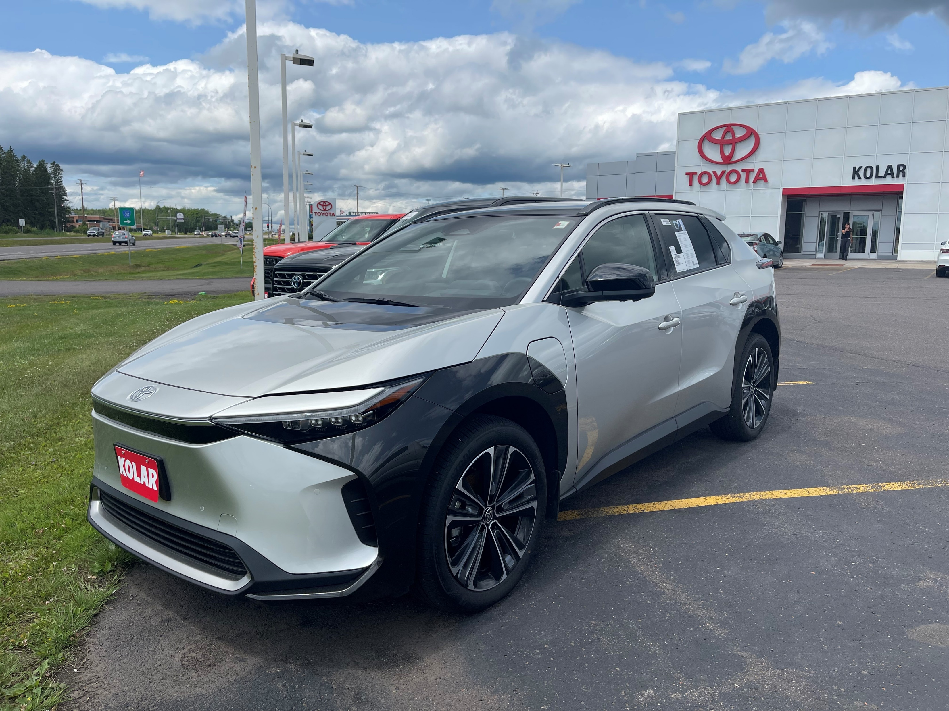
Toyota Bz4x

Slide 13
Comparison of Three New EV’s
Vehicle | Range | Battery kWh | Starting Price | Charging Capacity L2/L3 | Ground Clearance
Mustang Mach-E AWD Premium Standard Range | 226 | 72 | $50,000 | 10.5kW/115kW | 5.8 inches
Subaru Solterra AWD Limited | 222 | 72.8 | $48,500 | 6.6kW/100kW | 8.3 inches
Toyota Bz4x AWD Limited | 222 | 72.8 | $48,800 | 6.6kW/100kW | 8.1 inches

Slide 14
Topic 4 - Home L2 Charger Options Xcel Program Chargers

Slide 15
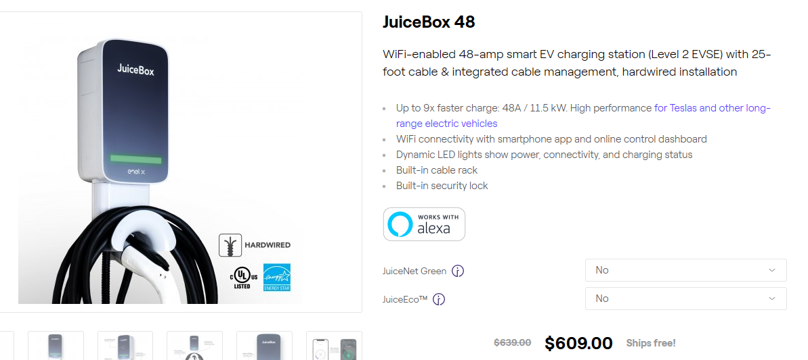

Slide 16
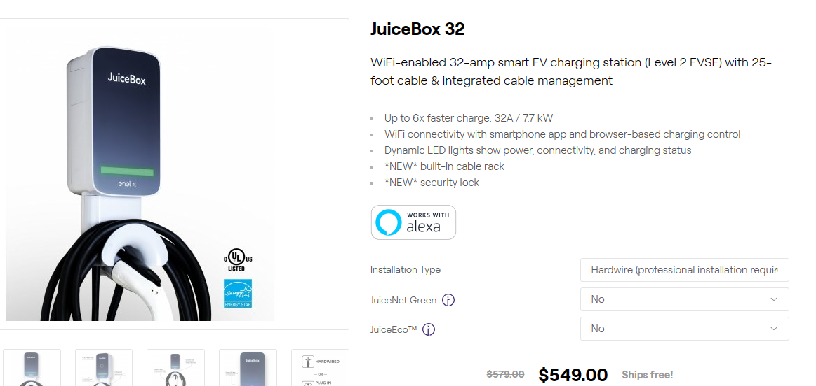

Slide 17
US Department of Energy (DOE) Office of Clean Energy Demonstrations (OCED) Funding Opportunity Announcement (FOA) DE-FOA-0002970 Energy Improvement in Rural or Remote Areas
Topic 5 - DOE ERA Program
Bipartisan Infrastructure Law (BIL) November 2021
$550B 2022-2027
Roads / Bridges
Energy $73B
Grid Deployment
FOA 2970
(Projects: $5M-$100M) $300M
Grant 3045
(Projects: $500k-$5M)
$50M
Prize Competition
$15M
Transportation Safety
Broadband
Mass transit / Rail
Water infrastructure
OCED $21B
Long Duration Energy Storage
Energy for Rural or Remote Areas
$1B
Carbon Capture
…6 More Demo Programs…

Slide 18
DOE Office of Clean Energy Demonstrations (OCED)
DOE Energy Improvements in Rural or Remote Areas (ERA)
FOA 2970 – 23 microgrids in Bayfield County
Many have Level-2 chargers included
4 F150 Ford Lightning pickup trucks included
FOA 3034 – Madeline Island
2 microgrids
Level-2 chargers included
Long Duration Energy Storage – Madeline Island

Slide 19
Resilience and Prosperity in Rural Northern Wisconsin Project Partners – FOA 2970
State of Wisconsin
Office of Sustainability and Clean Energy (OSCE) Prime Applicant
Public Service Commission (PSC)
Bayfield County
Red Cliff Band
muGrid Analytics (Program Leadership and Community Support)
Towns and Villages
Cheq Bay Renewables
Wisconsin Economic Development Corporation (WEDC) Office of Rural Prosperity (ORP)
Slipstream, Inc
muGrid Analytics (Project Technical Support)

Slide 20
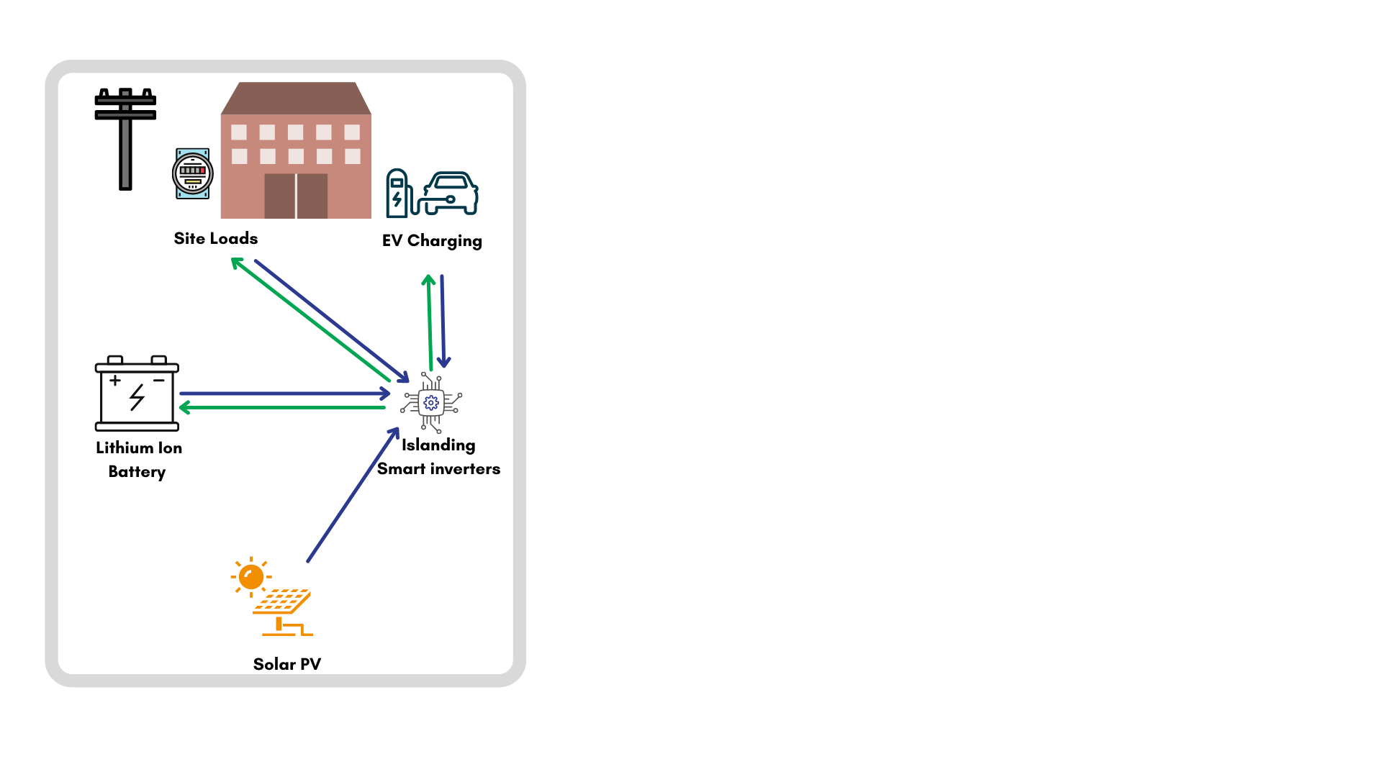
Town Microgrid Architecture
Most Projects

Slide 21
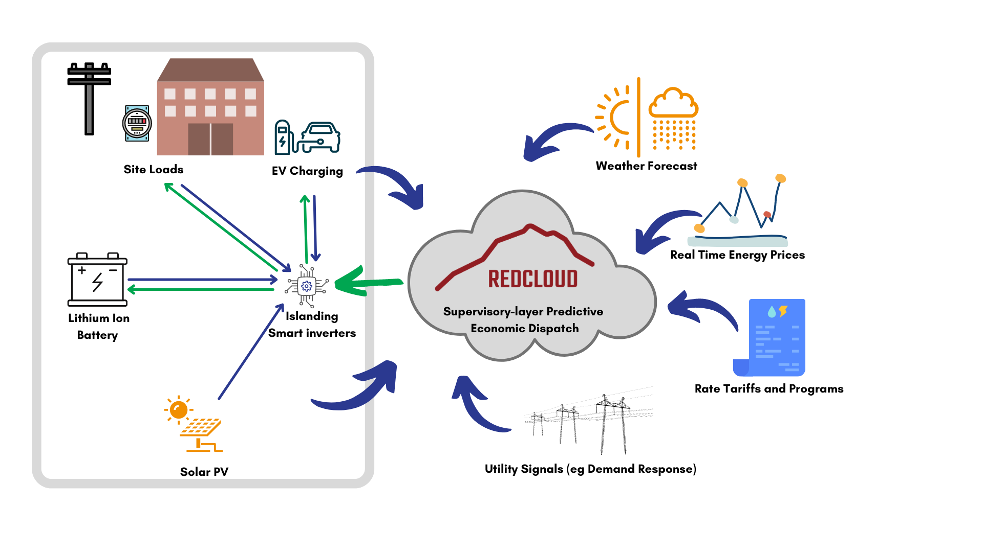
Town Microgrid Architecture
Some (larger, more complex) Projects

Slide 22
DRAFT GRANT BUDGET
Projects | Amount
Bayfield County 5 Highway Garage Microgrids | $1,297,010
Bayfield County CNG Fueling Station and Plow Trucks | $2,900,000
7 Bayfield County Local Units of Government - Microgrids | $1,354,806
Port Wing - 5 Microgrids including WWTP | $817,542
Red Cliff 2 microgrids | $1,964,313
Workforce Development | $1,628,272
Community Engagement | $351,670
Programmatic Support | $1,149,901
Total Project Cost | $11,614,956

Slide 23
Thank You
From Cheq Bay Renewables
Bill Bailey
billebailey2@gmail.com
www.cheqbayrenewables.org

