Slide 1
Department of Energy Grant Energy in Rural or Remote Areas
State of Wisconsin
Wisconsin Office of Sustainability and Clean Energy
Bayfield County + Towns
Red Cliff Band of Lake Superior Chippewa
WEDC Office of Rural Prosperity
Cheq Bay Renewables
muGrid Analytics
Slipstream

Slide 2
AGENDA
Introductions
Grant Overview and Project Partners – Amy
Project Overview, Architecture, and Budget - Bill
Grant Process and Scoring Criteria – Laura
Bayfield County CNG – Mark
Q & A

Slide 3
US Department of Energy (DOE) Office of Clean Energy Demonstrations (OCED) Funding Opportunity Announcement (FOA) DE-FOA-0002970 Energy Improvement in Rural or Remote Areas
ERA Program Pedigree
Bipartisan Infrastructure Law (BIL) November 2021
$550B 2022-2027
Roads / Bridges
Energy $73B
Grid Deployment
FOA 2970
(Projects: $5M-$100M) $300M
Grant 3045
(Projects: $500k-$5M)
$50M
Prize Competition
$15M
Transportation Safety
Broadband
Mass transit / Rail
Water infrastructure
OCED $21B
Long Duration Energy Storage
Energy for Rural or Remote Areas
$1B
Carbon Capture
…6 More Demo Programs…

Slide 4
SPECIFICATIONS ACROSS TOPIC AREAS- MUST SATISFY AT LEAST ONE
Improving overall cost-effectiveness of energy generation, transmission, or distribution systems.
Siting or upgrading transmission and distribution lines.
Reducing greenhouse gas emissions from energy generation in rural or remote areas.
Providing or modernizing electric generation facilities.
Developing microgrids.
Increasing energy efficiency.

Slide 5
PROJECT PHASES
For full resolution, see FOA guidance document page 39

Slide 6
Resilience and Prosperity in Rural Northern Wisconsin Project Partners
State of Wisconsin
Office of Sustainability and Clean Energy (OSCE) Prime Applicant
Public Service Commission (PSC)
Bayfield County
Red Cliff Band
muGrid Analytics (Program Leadership and Community Support)
Towns and Villages
Cheq Bay Renewables
Wisconsin Economic Development Corporation (WEDC) Office of Rural Prosperity (ORP)
Slipstream, Inc
muGrid Analytics (Project Technical Support)

Slide 7
Project Theme: “Stronger Together”
23 Projects
22 Microgrids (Solar PV, Battery, some EV Charging)
5 Bayfield County Highway Garages
2 Red Cliff Band Facilities
1 CNG fueled snowplows
1 Bayfield County Highway Garage
15 facilities in 8 Communities
Plus:
Workforce development, job creation, skilled training
Community engagement, education
Connection to and visibility with state agencies

Slide 8
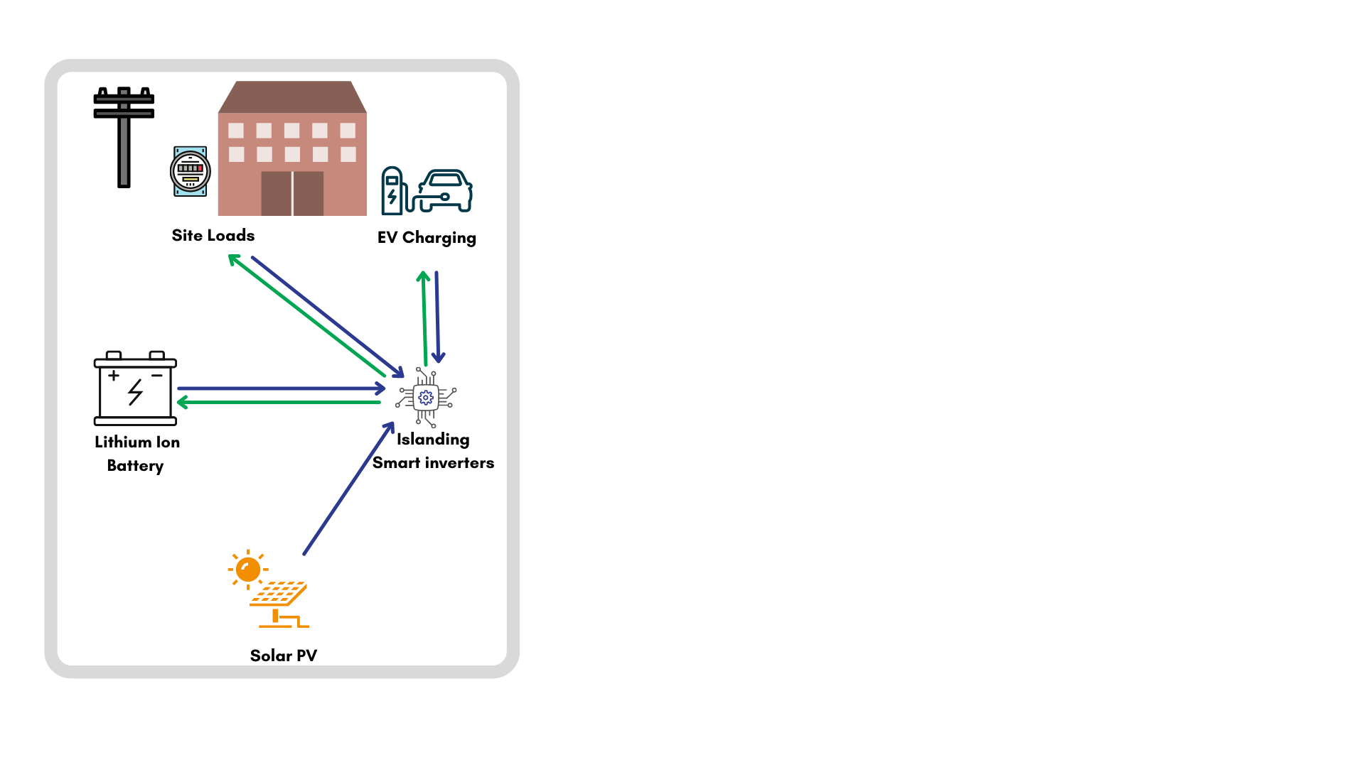
Town Microgrid Architecture
Most Projects

Slide 9
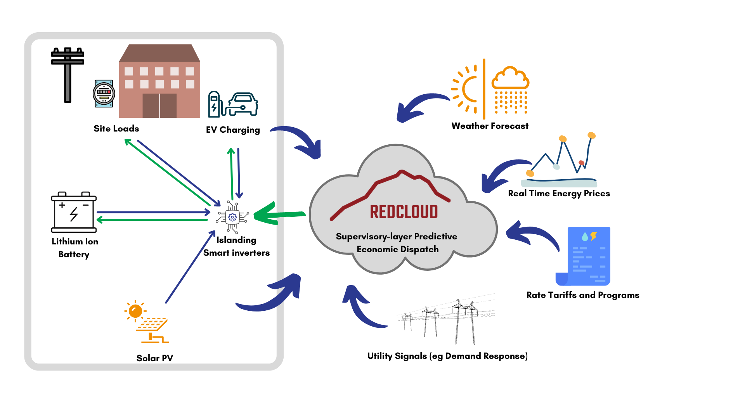
Town Microgrid Architecture
Some (larger, more complex) Projects

Slide 10
BENEFITS
Economic Opportunities
Utility bill savings
Community
Resilient backup power – extreme weather events in Great Lakes coastal area / high outage frequency, long recovery times
Individuals
Clean energy – health benefits as a result of emissions reduction
EV charging revenue – locals and tourists
Meeting energy needs locally (state, county, Tribe, town) – keeping energy spending locally and lower cost energy
Future opportunities
Market interaction (FERC2222)
Demand response
EV charging availability
Clean energy – GHG emission reduction / pollution reduction
Building workforce / capacity
Solidifying critical service delivery (fire, EMS, public safety)
Opportunities for training and jobs
Community pride

Slide 11
Resilience and Prosperity in Rural Northern Wisconsin PROJECT TIMELINE & BUDGET
Project timeline: 4.5 years for 4 phases
Phase 1 (Plan): June 2024 – January 2025
Phase 2 (Engineer/Procure): Begins January 2025
Phase 3 (Build): Half in summer 2025 and half in summer 2026
Phase 4 (Operate): 12 months from project completion
Post-demonstration: Towns/Village retains ownership; project revenues cover O&M costs
Total budget (still in refinement): $10.5M
20% Cost Share covered by sites and project partners

Slide 12
DRAFT GRANT BUDGET
Projects | Amount
Bayfield County 5 Highway Garage Microgrids | $1,242,010
Bayfield County CNG Fueling Station and Plow Trucks | $2,750,000
7 Bayfield County Local Units of Government - Microgrids | $1,244,146
Port Wing - 5 Microgrids including WWTP | $775,742
Red Cliff 2 microgrids | $1,947,055
Workforce Development | $1,628,272
Community Engagement | $351,670
Programmatic Support | $543,802
Total Project Cost | $10,482,697

Slide 13
Seven Town Grant & Cost Share (includes contingency)
 | Grant 80% | Cost Share (20%)
Town of Washburn | $95,590 | $23,898
Town of Clover | $125,598 | $31,400
Town of Drummond (3 microgrids) | $209,728 | $52,432
Village of Mason (2 microgrids) | $276,096 | $69,024
Town of Grandview | $107,294 | $26,824
Town of Kelly | $107,400 | $26,850
Drummond Sanitary District | $73,612 | $18,403
Total | $995,317 | $248,829

Slide 14
Seven Town Microgrid Cost Share
 | Cost After Potential Additional Incentives | Adjusted Cost Share
Town of Washburn | $13,728 | 11.5%
Town of Clover | $15,480 | 9.9%
Town of Drummond (3 microgrids) | $27,874 | 10.6%
Village of Mason (2 microgrids) | $36,567 | 10.6%
Town of Grandview | $12,651 | 9.4%
Town of Kelly | $14,970 | 11.2%
Drummond Sanitary District | $10,734 | 11.7%
Total | $132,004 | 10.7%

Slide 15
Port Wing 5-Facility Project Cost Share
 | Total with Contingency | Grant 80% | Cost Share (20%)
Waste Water Treatment Plant | $281,677 | $225,342 | $56,335
Town Hall | $92,290 | $73,832 | $18,458
Garage | $151,415 | $121,132 | $30,283
Well | $172,920 | $138,336 | $34,584
Fire Hall | $77,440 | $61,952 | $15,488
Total | $775,742 | $620,594 | $155,148

Slide 16
Port Wing Projects Cost Share
Port Wing | Cost Share (20%) | Cost After Potential Additional Incentives | Adjusted Cost Share
Waste Water Treatment Plant | $56,335 | $20,572 | 7.3%
Town Hall | $18,458 | $7,071 | 7.7%
Garage | $30,283 | $17,758 | 11.7%
Well | $34,584 | $10,184 | 5.9%
Fire Hall | $15,488 | $6,722 | 8.7%
Total | $155,148 | $62,306 | 8.3%

Slide 17
Grant Process Flow
Concept Paper
Full Application
Award Announcement
Contract Negotiations
Program Start
Due April 2023
Encouraged to apply
Due August 2
In Process
Substantive completion July 19
November 2023
Spring 2024
June 2024
2029
Demonstration Program Complete
Estimated
Projects continue in “sustained operations”

Slide 18
Grant Scoring
Technical Review Criteria
1 | Technical Merit, Innovation, & Input | 30%
2 | Financial and Market Viability | 20%
3 | Workplan | 15%
4 | Management Team & Project Partners | 15%
5 | Community Benefits Plan | 20%

Slide 19
Bayfield County Compressed Natural Gas (CNG)
PLOW TRUCKS, FUELING AND MAINTEANNCE FACILTY UPGRADES, WASHBURN WISCONSIN

Slide 20
CNG: * ECONOMICAL: Half the cost of diesel, less fluctuation * CLEAN: Lower emissions than Diesel * CONVIENIENT: Natural gas is always available plus no DEF requirements
Current Bayfield County CNG Fleet: Sheriff, Forestry, Health
How it works:
Natural Gas from Xcel is compressed to 3600 psi.
Modified vehicles with CNG tanks.

Slide 21
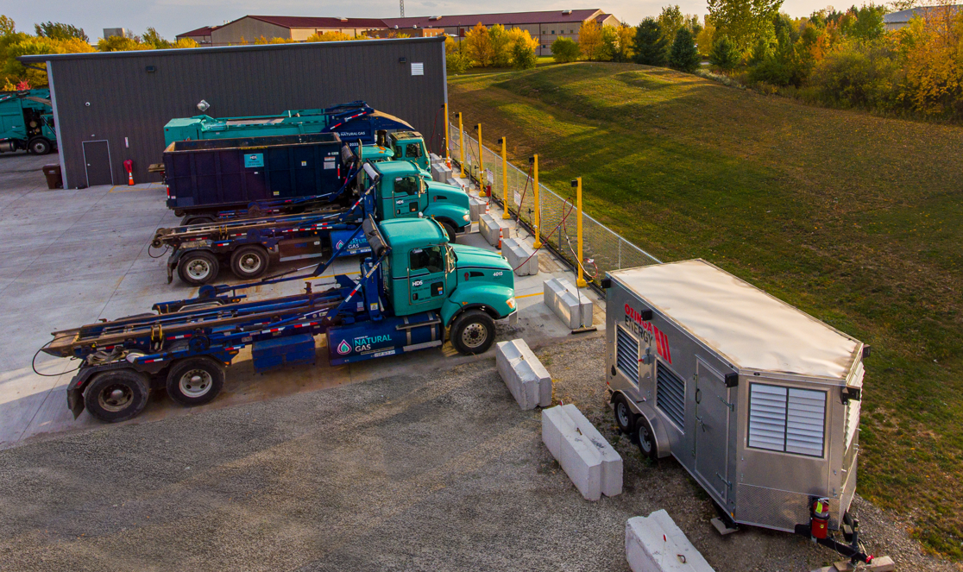
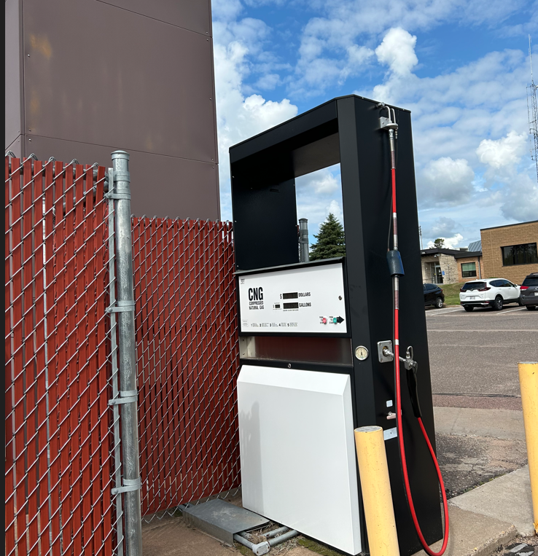
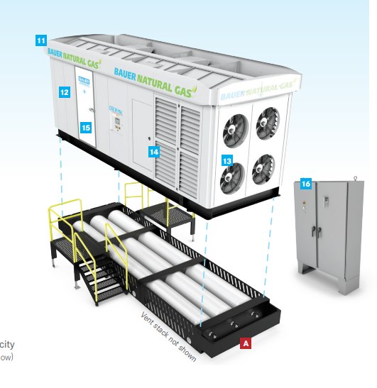
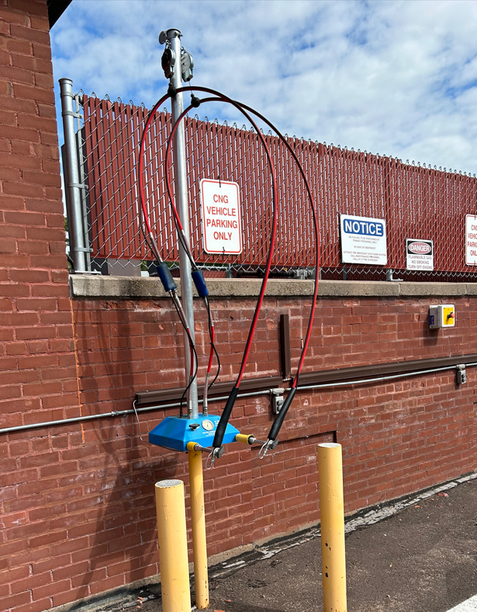
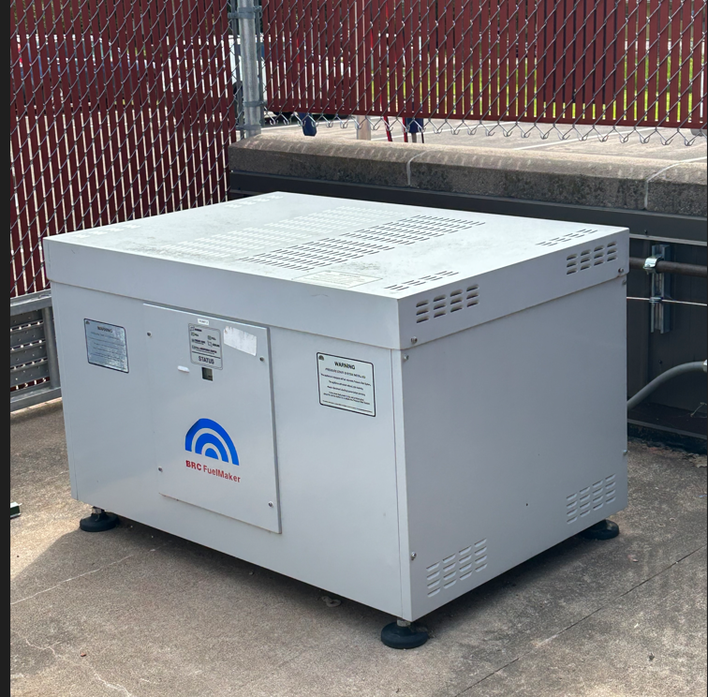
CNG FUELING STATION
Slow fill, fast fill, compressors & storage

Slide 22
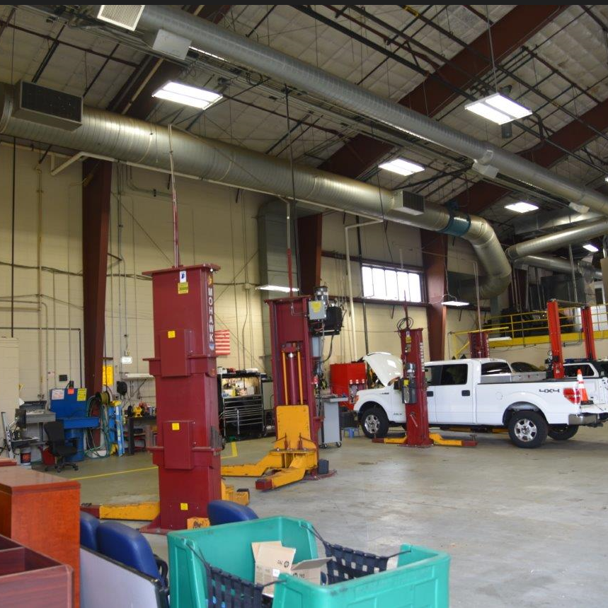
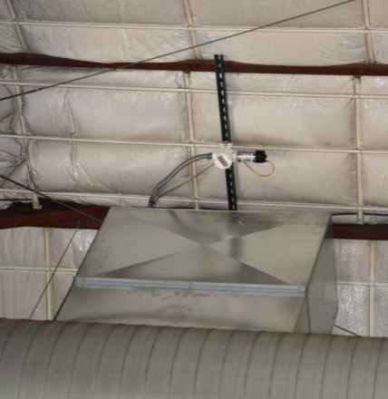
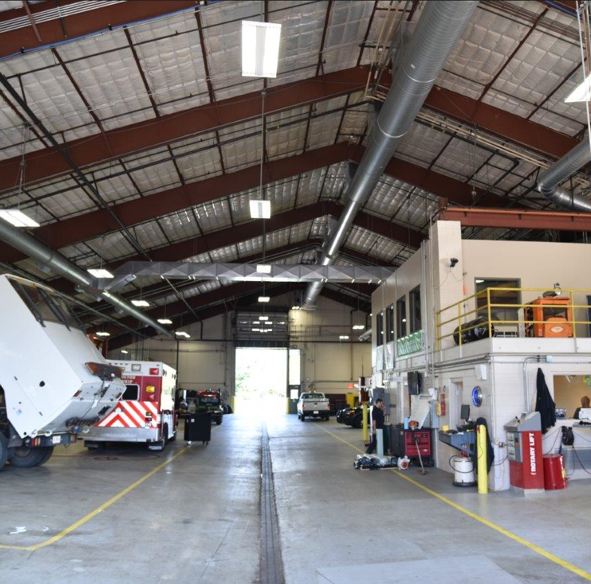
FACILITY UPGRADES: HVAC, Gas Detectors, Wiring

Slide 23
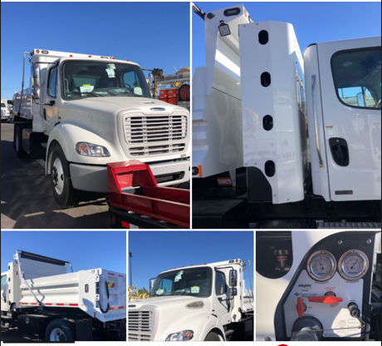
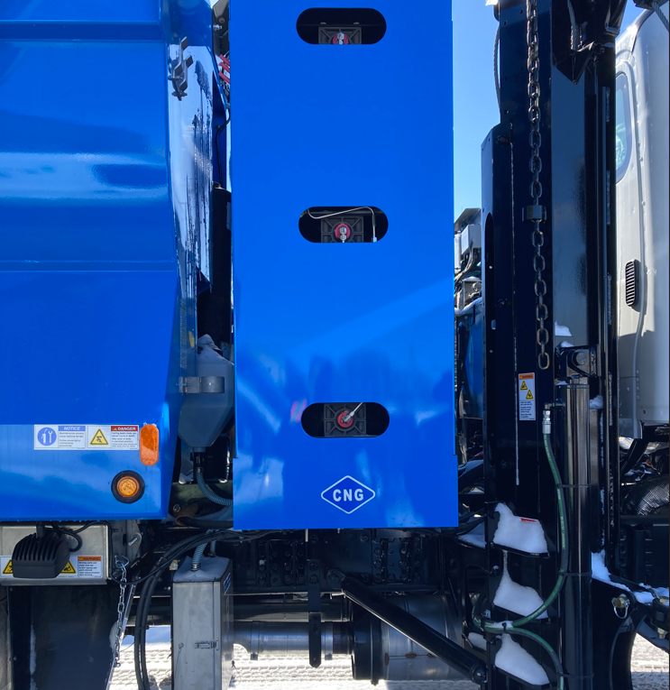
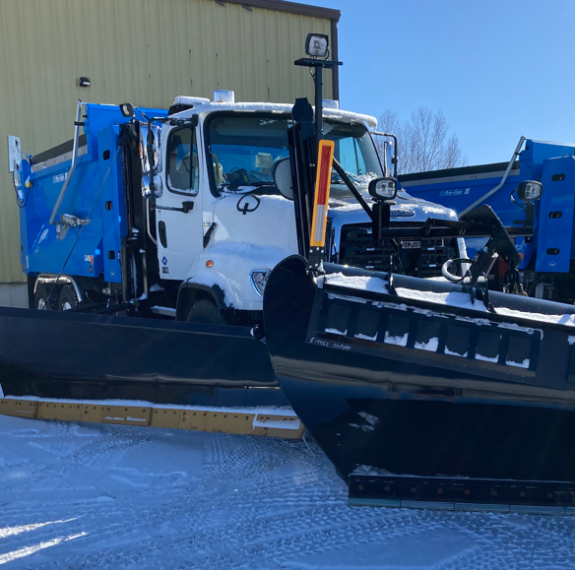
CNG PLOW TRUCKS

Slide 24
What we need from you
A letter of commitment or resolution that you will be part of the program, if awarded

Slide 25
THANK YOU
Amy Simpkins amy@mugrid.com
Laura Novak Laura.novak@mugrid.com
Bill Bailey billebailey2@gmail.com
Mark Abeles-Allison Mark.Abeles-Allison@bayfieldcounty.wi.gov

