Slide 1
Renewable Energy in the Chequamegon Bay “Grassroots solar”
Cheq bay renewables

Slide 2
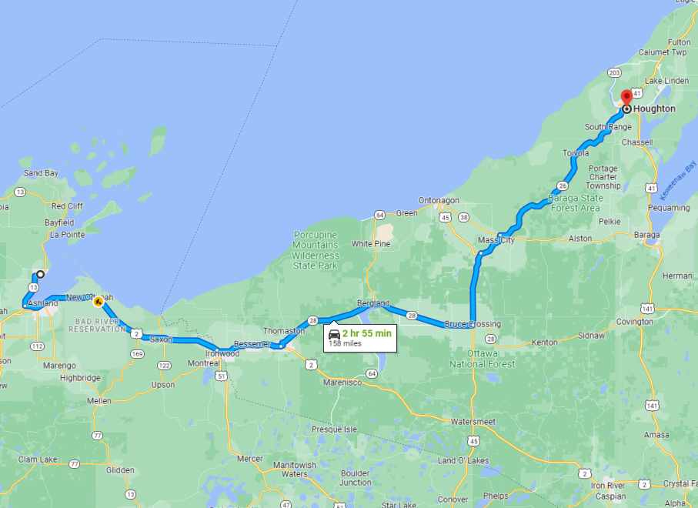

Slide 3
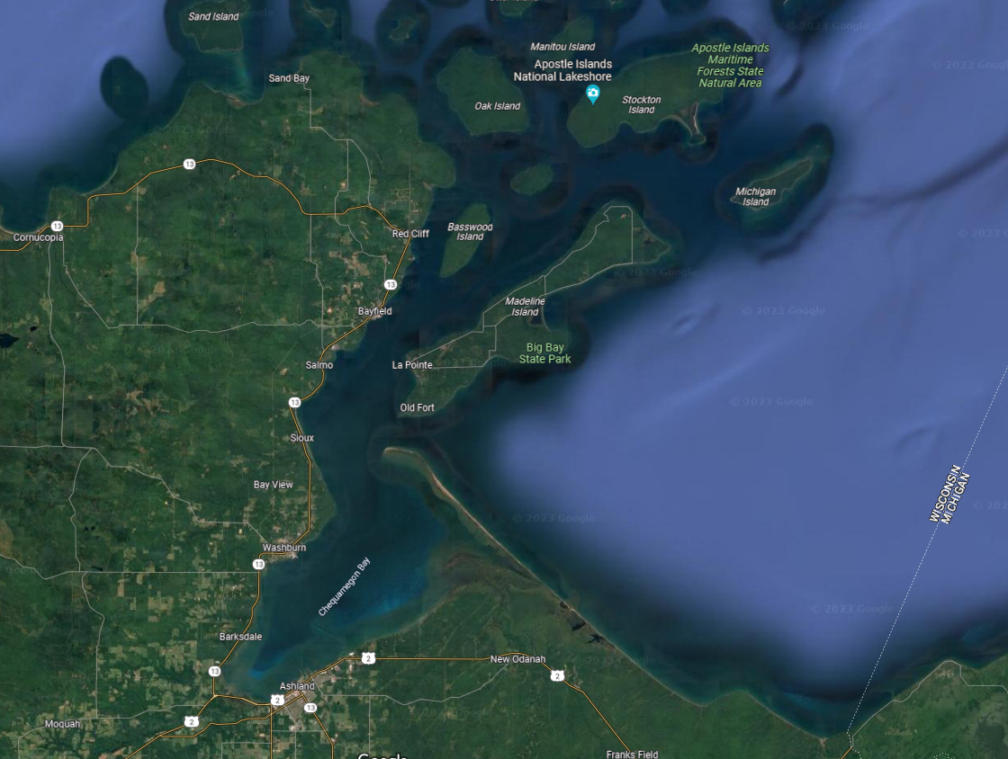

Slide 4
Cheq bay renewables
501 (c)3 nonprofit
100% volunteer
Do not charge for services

Slide 5
Cbr services
Project development
Engage with area Muni's, tribes, utilities
Financial planning
Grant writing
Energy tracking

Slide 6
A very brief history in time
2009
Energy Independent Communities 25 x 25
2018
Xcel Community Solar Garden,
CBR Largest solar group buy in WI history
2019
2016
Bayfield Electric Solar Garden
Second largest solar group buy in WI history
2020
Washburn/Bayfield Community solar project complete
2021
Bad River completes 3 microgrids with largest battery storage in WI
Bayfield County 100% carbon-free electricity

Slide 7
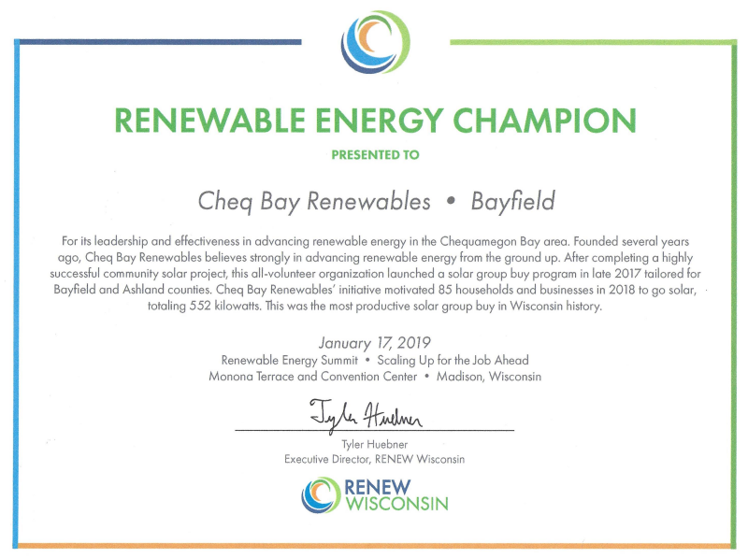
2018 & 2019
Largest Solar Group Buy in WI History –Twice

Slide 8
2020 Washburn-Bayfield Community solar project

Slide 9
2020 - 100% carbon free electricity – Bayfield County -only county -30-years ahead

Slide 11
2021 Bad river – largest battery storage system in Wisconsin

Slide 12
Bad river – renew Wisconsin - clean energy honor roll 2022

Slide 13
The point?
CBR has no budget – none required
CBR is basically one person – no staff required
A lot can be accomplished at the local level

Slide 14
What’s next - Current projects
Advanced Technology:
Northern Lights -120kW (bifacial panels)
Bayfield County Jail & Courthouse microgrid (real-time interface – AI)
Bayfield County Washburn Highway Garage microgrid (Smart EV charging)
Northern Lights Jan. 4, 2023

Slide 15
Projects in the works
Red Cliff Comprehensive Energy Plan, EV Charging, Microgrids
Bayfield County county-wide EV Charging Infrastructure
DOT CFI grant
State of WI DOE ERA grant for Bayfield County carbon reduction ($10M)
Bad River study of utility infrastructure – 5mW solar + storage “mini-grid”

Slide 16
New funding Inflation reduction Act (IRA) Bipartisan infrastructure Law (BIL)
Once in a generation opportunity

Slide 17
IRA & BIL – funds allocated by U.S. Departments
U.S. Department of Energy
Energy Efficiency & Conservation Block Grant (EECBG)
Energizing Rural Communities (ERC/ERA)
Grid Resiliency 40101(d)
U.S. Department of Transportation
Rebuilding American Infrastructure with Sustainability and Equity (RAISE)
Rural Opportunities to use Transportation for Economic Success (ROUTES)
Charge Forward – Toolkit for Planning and Funding Rural Electric Infrastructure
National Electric Vehicle Infrastructure Plan (NEVI)(CFI)

Slide 18
New funding – IRA & BIL (Continued)
U.S. Treasury – Internal Revenue Service
Extended Investment Tax Credit to 3032 and raises it to 30%
Offers Direct Pay option for nonprofits and municipalities
Expands definition to include Electric Vehicle infrastructure
Fact Sheet

Slide 19
New funding – IRA & BIL (Continued)
U.S. Department of Agriculture
Rural Energy for America Program (REAP)
Rural Resilience
Broadband
Fact Sheet
Department of the Interior
Water projects
Drought resilience projects
Legacy pollution
Restoration projects
Fact Sheet

Slide 20
New funding – IRA & BIL (Continued)
State of Wisconsin
U.S. funds flow through state departments
WI Department of Transportation
WI EV Infrastructure funds
Office of Energy Innovation
Focus on Energy
U.S. EPA
Climate Pollution Reduction Grant (CPRG)
Clean Air Act Grants under the IRA
State of Michigan
Michigan: Environment, Great Lakes, and Energy

Slide 21
How can you help?
Do you have a local nonprofit supporting renewable energy?
If so, support it, if not, start one
Get involved with local government
Public input on Comprehensive Plans
Propose solar and EV infrastructure projects
Consider donating financially to a local community-based solar project.
Reduce your carbon footprint
Install solar at you home
Buy an electric vehicle
Does your community have examples?

Slide 22
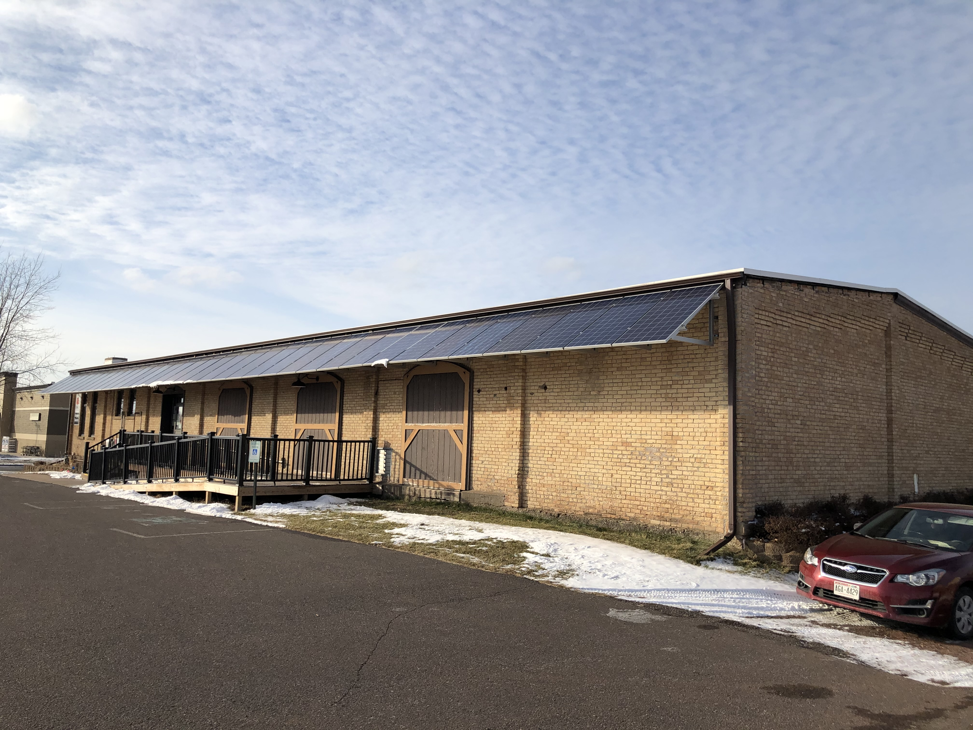
Example of community funded solar projects The brick food pantry
Panels donated by Solar Developer
Community Go Fund Me & direct donations $13K
Local installer built at cost

Slide 23
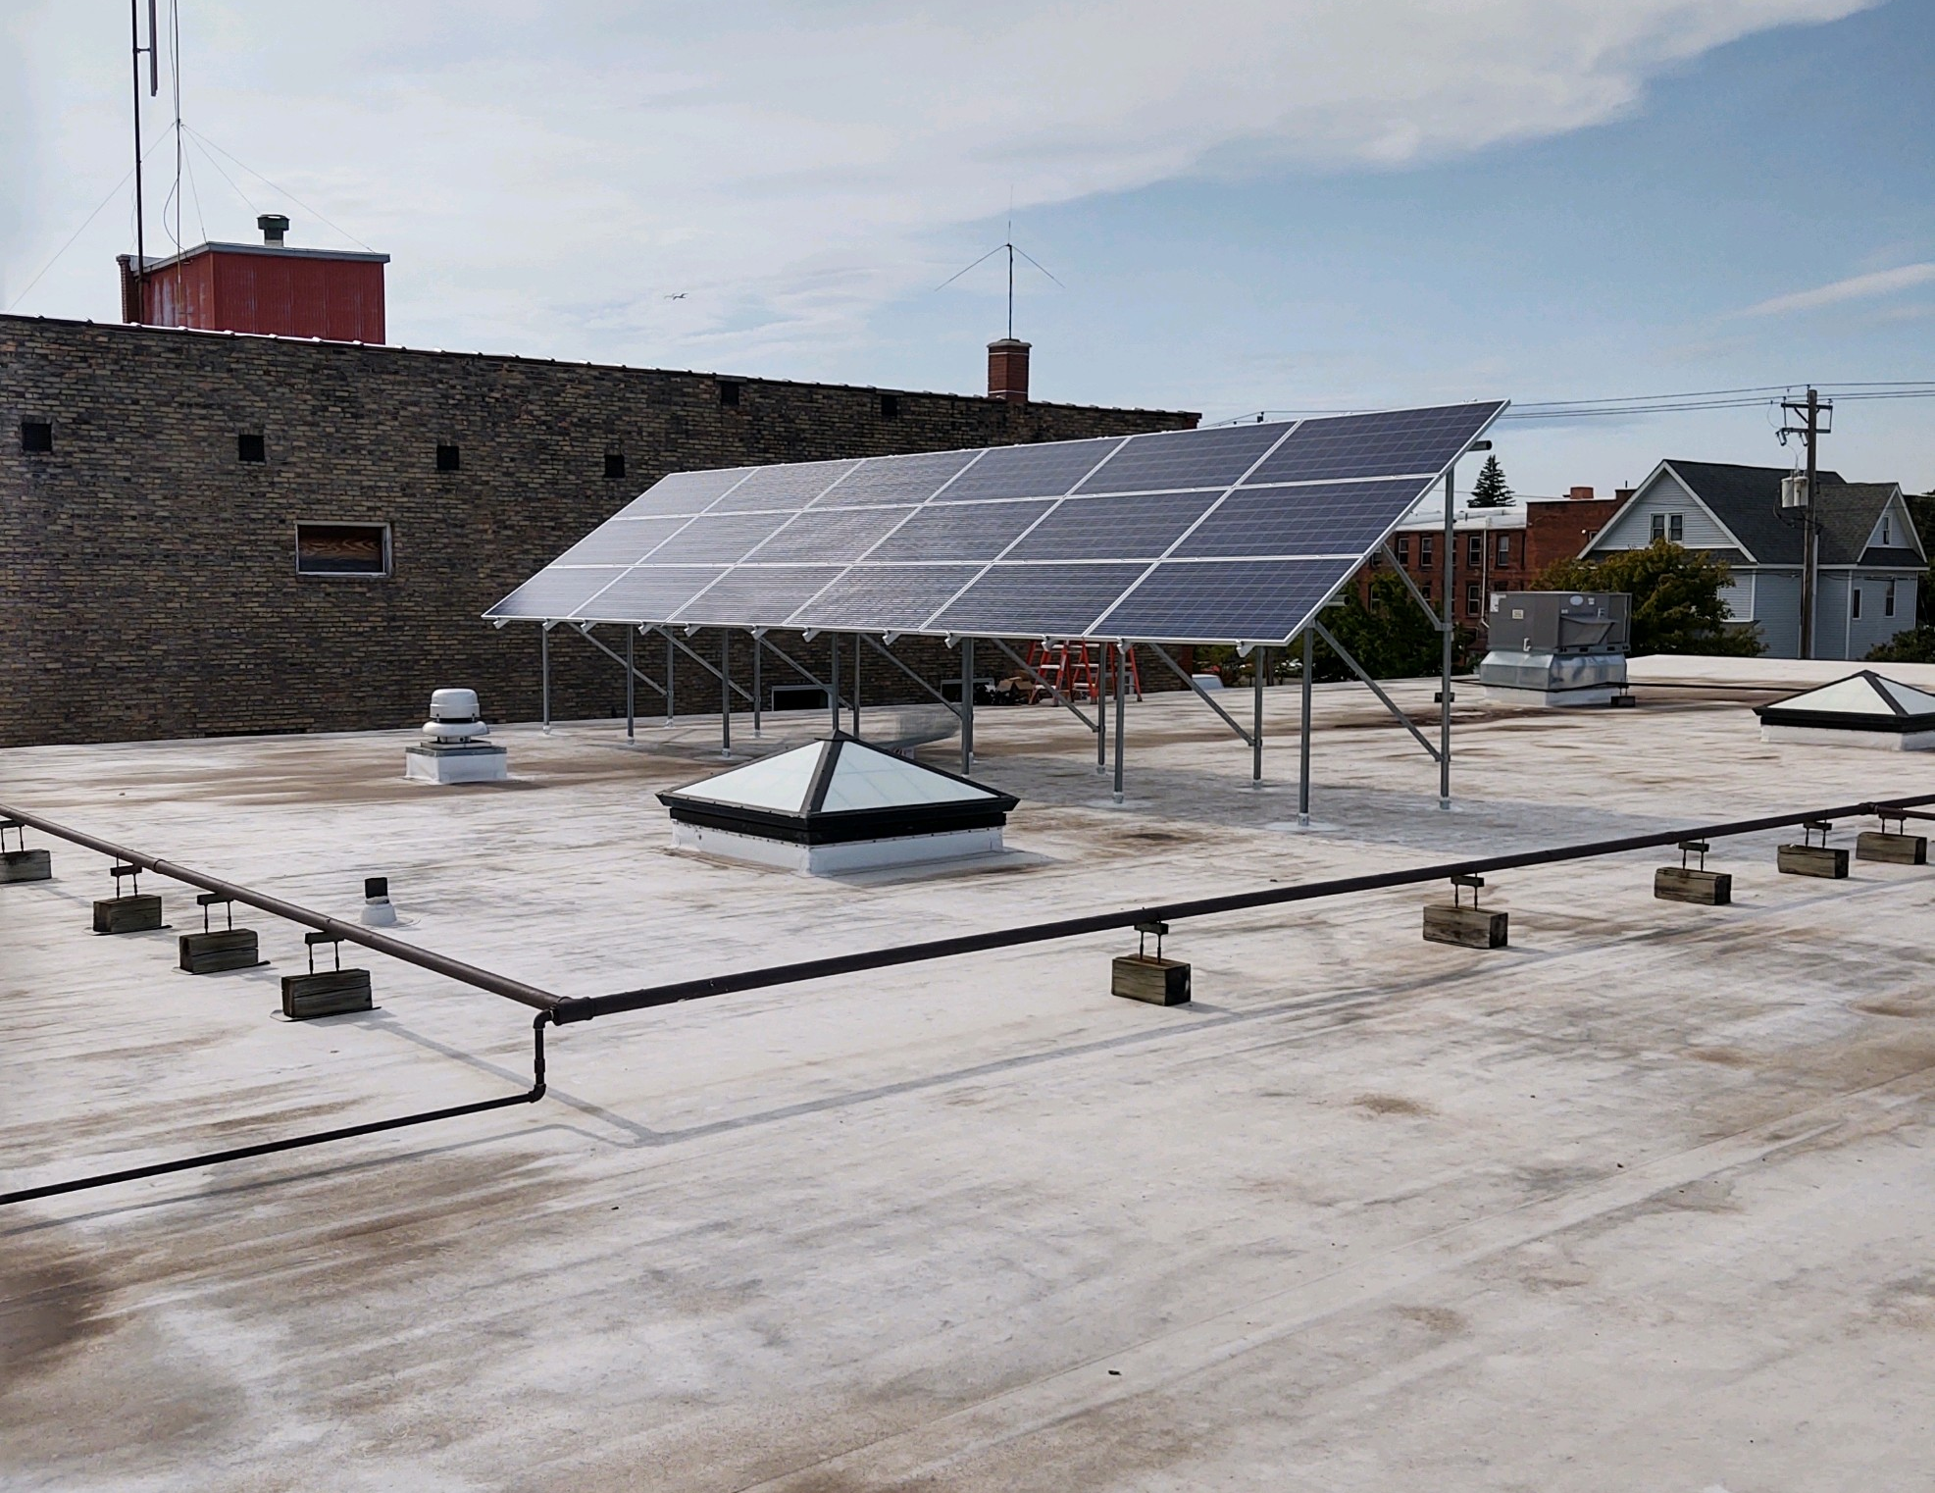
Example of community funded solar projects New day advocacy center
Panels donated by Solar Developer
Community Go Fund Me & direct donations $10.5K
Local installer built at cost

Slide 24
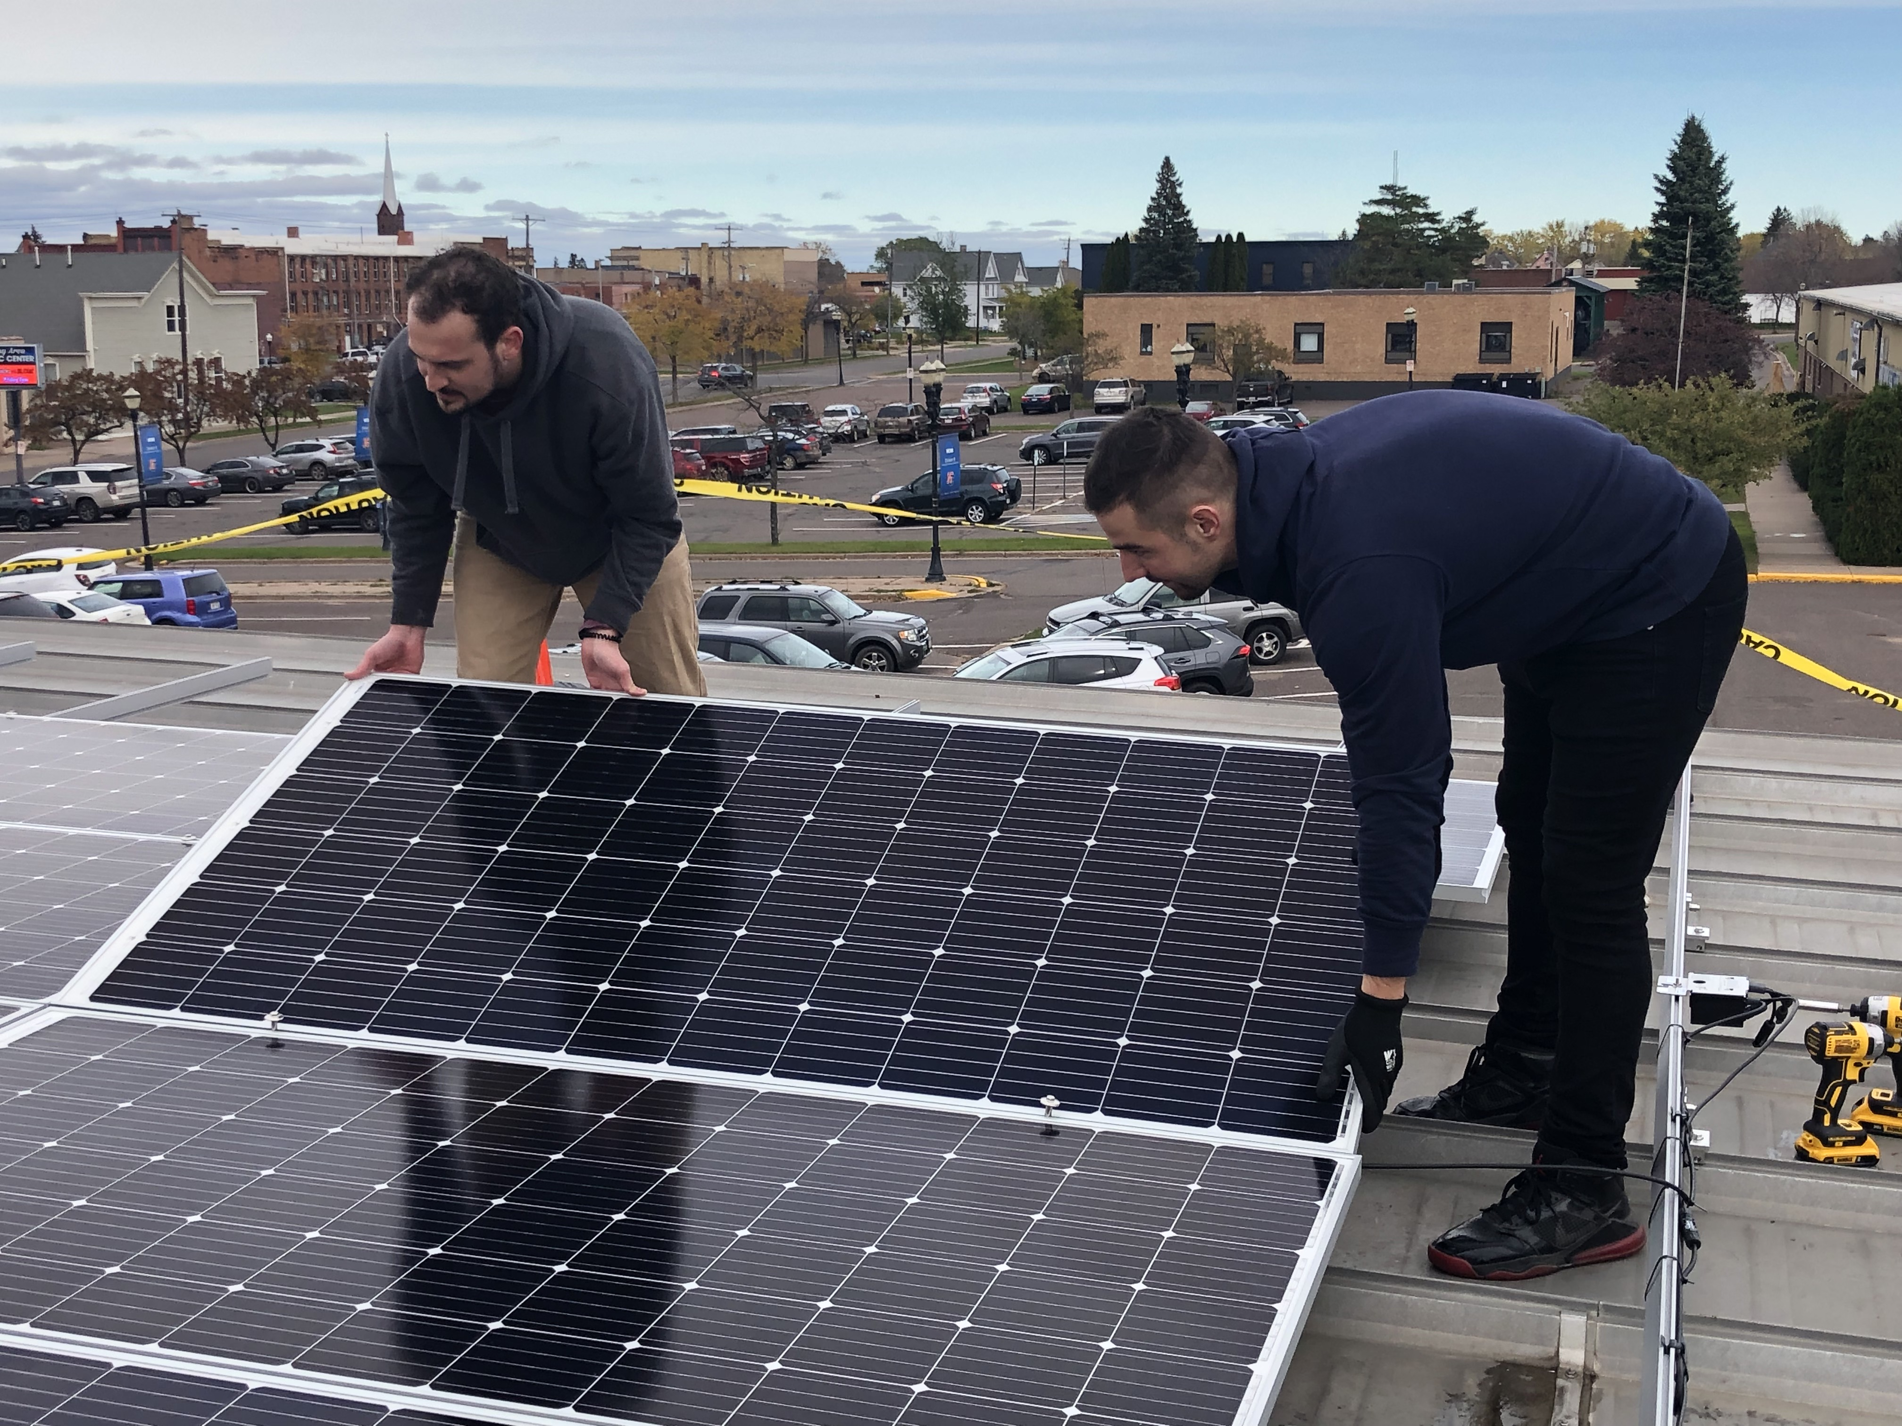
Example of community funded solar projects Ashland Area Development corp.
½ Panels Solar for Good
½ Panels donated by Solar Developer
120kW system
$70K loan State Land Trust
Cash flow positive from day 1

Slide 25
Community funding – northern lights nursing home 62% Grant funded, $26K Raised, Payback 4.5 years

Slide 26
Thank you
www.cheqbayrenewables.org
cheqbayrenewables@gmail.com

